Slide 1
2024 TEMPO/GEMS Joint Science Team Workshop
Current Status and Future Plans
for the Geostationary Environment Monitoring Spectrometer (GEMS) Operations
Kyunghwa Lee, Jaehoon Jeong, Goo Kim, Minseok Nam,
Jeonghyeon Seo, Mijeong Kim, Dongwon Lee
Myung Soo Yoo
Environmental Satellite Center (ESC)
Climate and Air Quality Research Department
National Institute of Environmental Research (NIER)

Slide 2
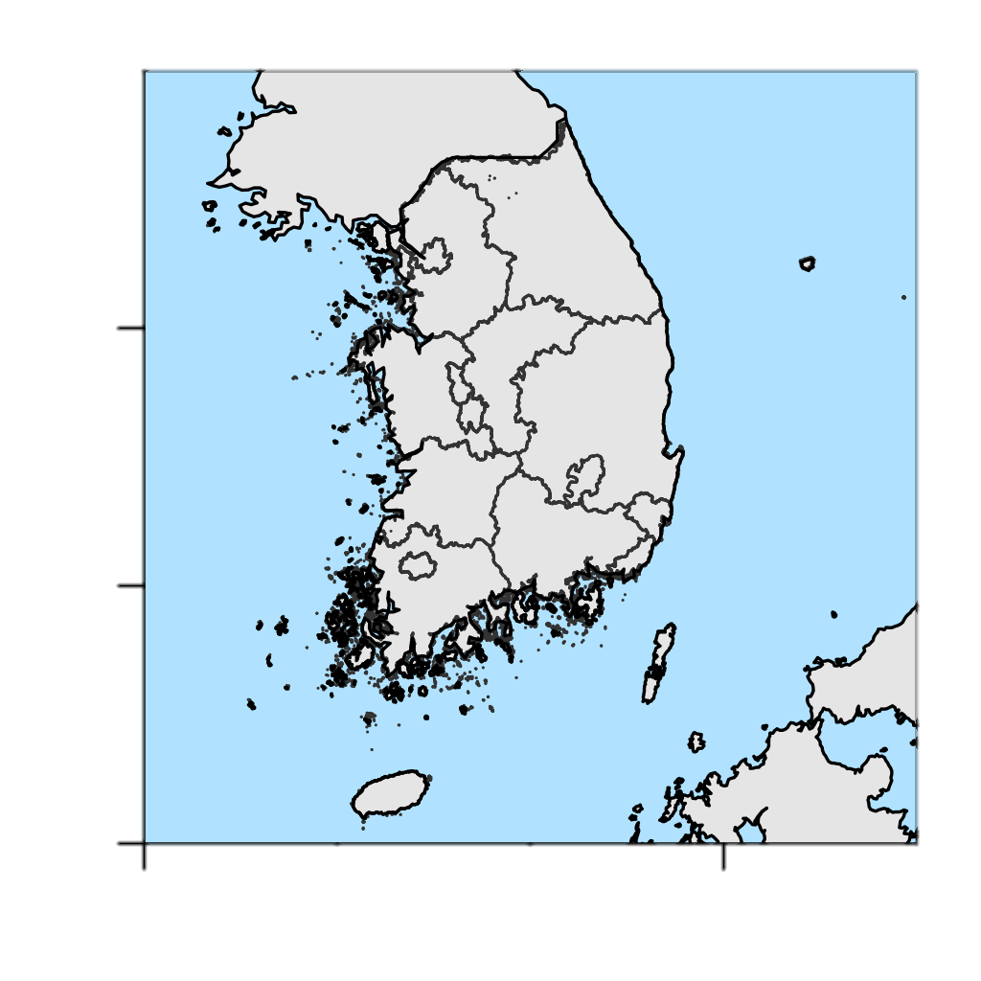
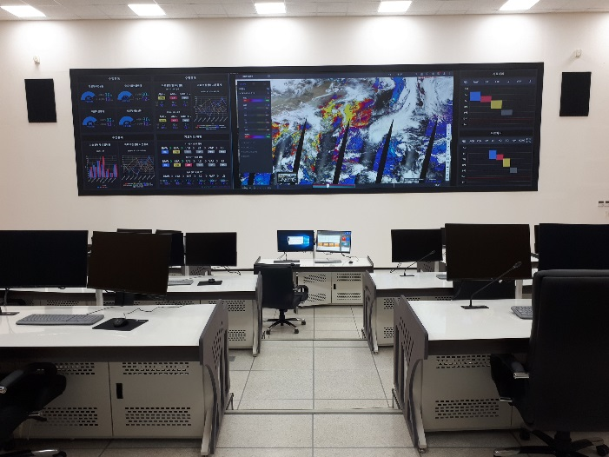
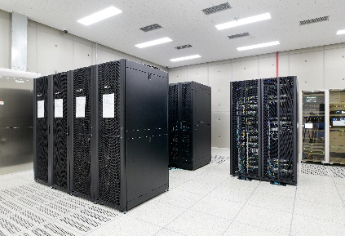
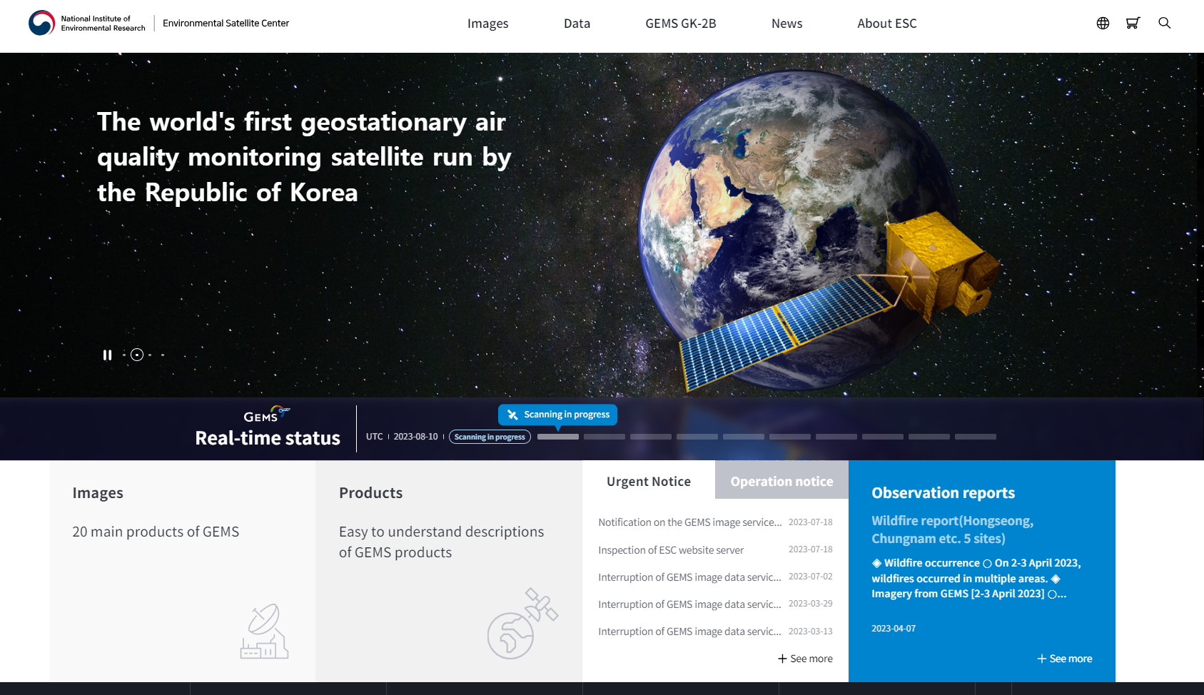
Introduction of ESC
Roles of the Environmental Satellite Center (ESC) in GEMS operations
Universities
Institutes
ESC
Data processing (L0-L4) & analyzing
Validation
Distribution
Air Quality Forecasting Center
Receiving
Data back-up & archiving
Public service
(http://nesc.nier.go.kr)
Monitoring
Now
LEOP
IN-Orbit Test (IOT)
L2 production / Validation
Distribution of image files
Distribution of NC files
19 Feb. 2020
Launch
8 Mar. 2020
Oct. 2020
Mar. 2021
Jun., Nov., 2022

Slide 3
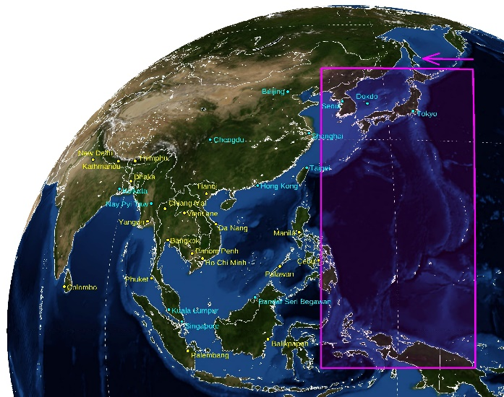
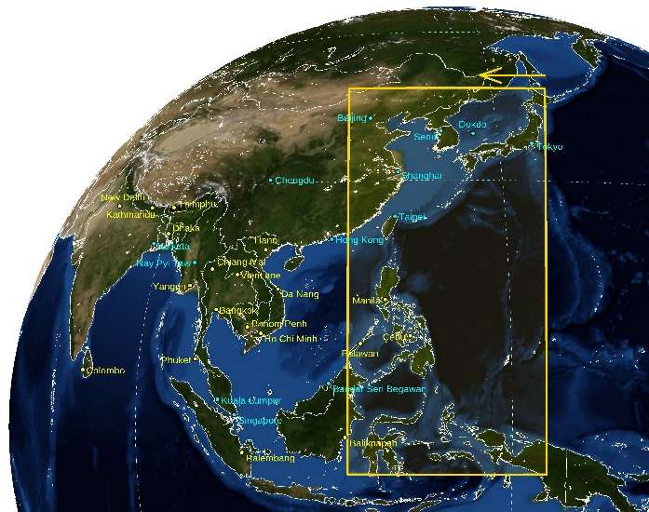
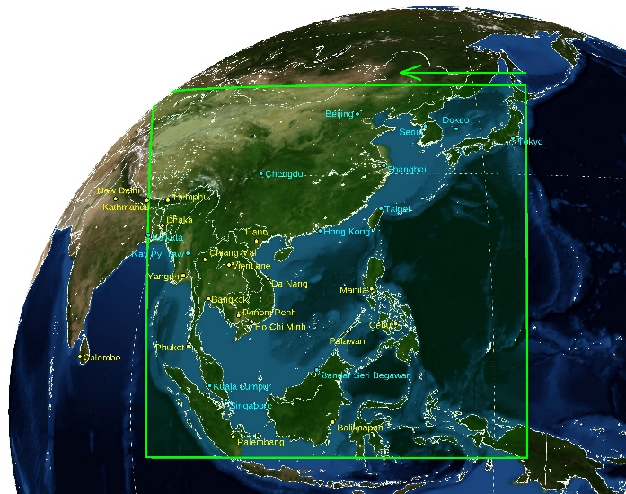
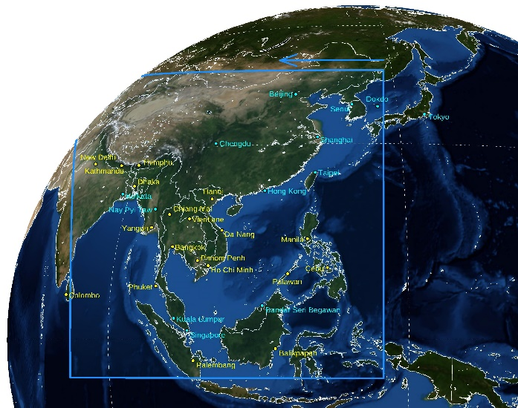
Current status of GEMS
Reschedule of GEMS observation since 1 FEB 2024
Half East
(HE)
Half Korea
(HK)
Full Central
(FC)
Full West
(FW)
+
-
Change
Month | 07:45 | 08:45 | 09:45 | 10:45 | 11:45 | 12:45 | 13:45 | 14:45 | 15:45 | 16:45 | #
1 | - | - | HE | HK | FC | FW | FW | FW | - | - | 6
2 | - | - | HE | HK | FC | FW | FW | FW | FW | - | 7
3 | - | HE | HK | FC | FC | FW | FW | FW | FW | - | 8
4 | HE | HK | FC | FC | FC | FW | FW | FW | FW | FW | 10
5 | HE | HK | FC | FC | FW | FW | FW | FW | FW | FW | 10
6 | HE | HK | FC | FC | FW | FW | FW | FW | FW | FW | 10
7 | HE | HK | FC | FC | FW | FW | FW | FW | FW | FW | 10
8 | HE | HK | FC | FC | FW | FW | FW | FW | FW | FW | 10
9 | HE | HK | FC | FC | FW | FW | FW | FW | FW | FW | 10
10 | - | HE | HK | FC | FC | FW | FW | FW | FW | - | 8
11 | - | - | HE | HK | FC | FW | FW | FW | - | - | 6
12 | - | - | HE | HK | FC | FW | FW | FW | - | - | 6
Month | 07:45 | 08:45 | 09:45 | 10:45 | 11:45 | 12:45 | 13:45 | 14:45 | 15:45 | 16:45 | #
1 | - | - | FC | FC | FC | FC | FW | FW | FW | - | 7
2 | - | HE | FC | FC | FC | FC | FW | FW | FW | - | 8
3 | - | HE | FC | FC | FC | FC | FW | FW | FW | - | 8
4 | HE | HK | FC | FC | FC | FC | FW | FW | FW | FW | 10
5 | HE | HK | FC | FC | FC | FC | FW | FW | FW | FW | 10
6 | - | HK | FC | FC | FC | FC | FW | FW | FW | FW | 9
7 | - | HK | FC | FC | FC | FC | FW | FW | FW | FW | 9
8 | - | HK | FC | FC | FC | FC | FW | FW | FW | FW | 9
9 | - | HK | FC | FC | FC | FC | FW | FW | FW | FW | 9
10 | - | HE | FC | FC | FC | FC | FW | FW | FW | - | 8
11 | - | HE | FC | FC | FC | FC | FW | FW | FW | - | 8
12 | - | - | FC | FC | FC | FC | FW | FW | - | - | 6

Slide 4
Current status of GEMS
Operation success rates
☯ Operation success rates
Nearly 100% for production/distribution & 98.9% for receiving GEMS data in 2024
Category | Earth Obs. | Receiving | L1A | L1B | L1C | L2
Jan.
Plan/Real | 232/232 | 232/231 | 232/231 | 232/231 | 232/232 | 232/232
Success rate(%) | 100.0 | 99.6 | 99.6 | 99.6 | 100.0 | 100.0
Feb.
Plan/Real | 232/232 | 232/231 | 232/231 | 232/231 | 232/232 | 232/232
Success rate(%) | 100.0 | 99.6 | 99.6 | 99.6 | 100.0 | 100.0
Mar.
Plan/Real | 248/248 | 248/246 | 248/246 | 248/246 | 248/248 | 248/248
Success rate(%) | 100.0 | 99.2 | 99.2 | 99.2 | 100.0 | 100.0
Apr.
Plan/Real | 300/300 | 300/297 | 300/297 | 300/297 | 300/300 | 300/300
Success rate(%) | 100.0 | 99.0 | 99.0 | 99.0 | 100.0 | 100.0
May
Plan/Real | 310/310 | 310/305 | 310/305 | 310/305 | 310/310 | 310/310
Success rate(%) | 100.0 | 98.4 | 98.4 | 98.4 | 100.0 | 100.0
AVG.
Plan/Real | 1317/1317 | 1317/1303 | 1317/1303 | 1317/1303 | 1317/1317 | 27657/27657
Success rate(%) | 100.0 | 98.9 | 98.9 | 98.9 | 100.0 | 100.0

Slide 5
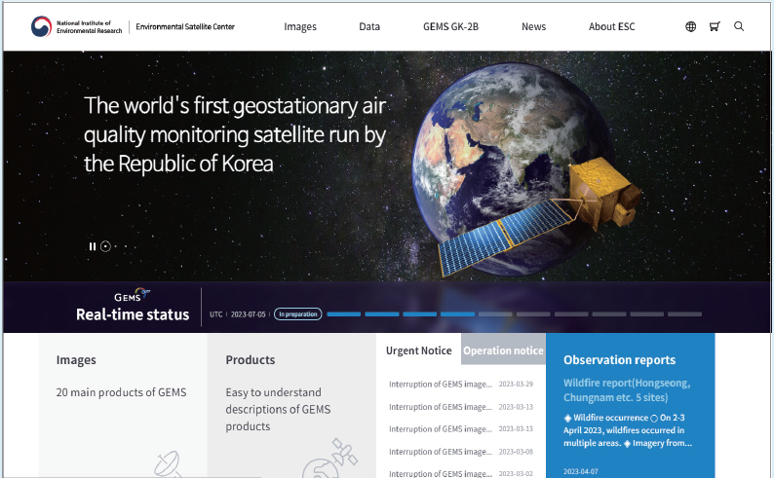
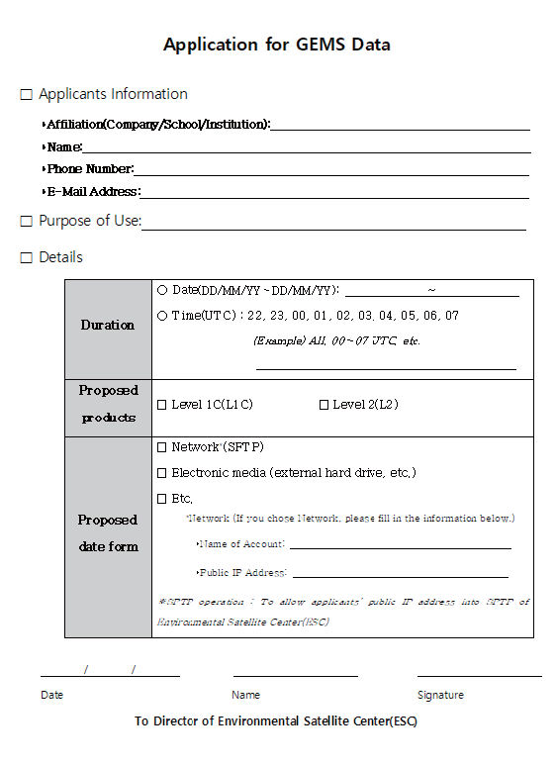
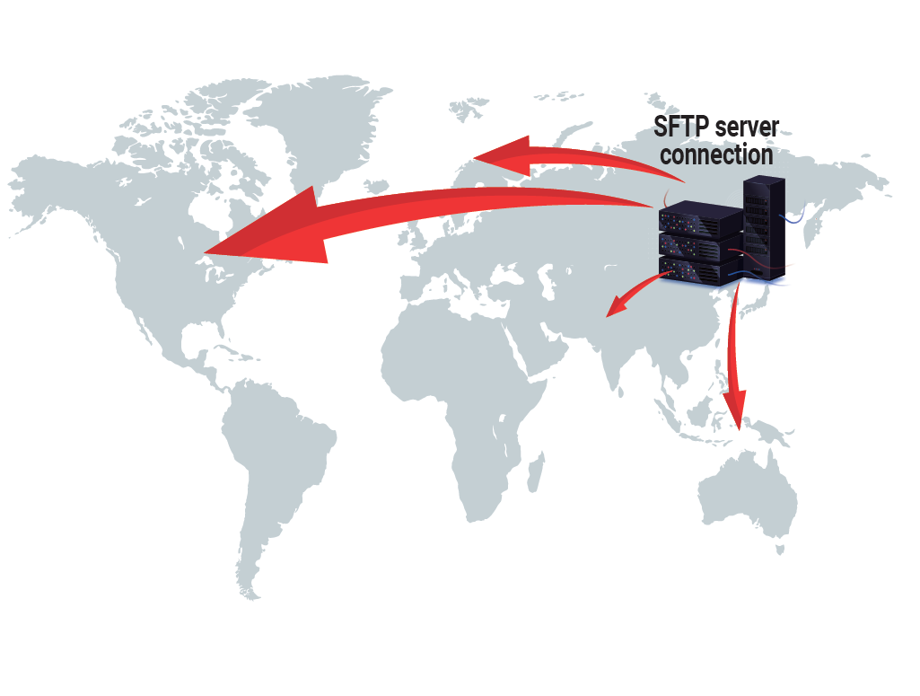
Current status of GEMS
Data distribution
Download from the ESC website (nesc.nier.go.kr)
Anyone can download GEMS data without logging in
Up to 20 GB and 40 files
SFTP service (A written application form required)
An account is issued for the user’s public IP address, which is allowed to pass through the ESC’s Web Application Firewall (WAF)
Log in to the SFTP server using the account and download data

Slide 6
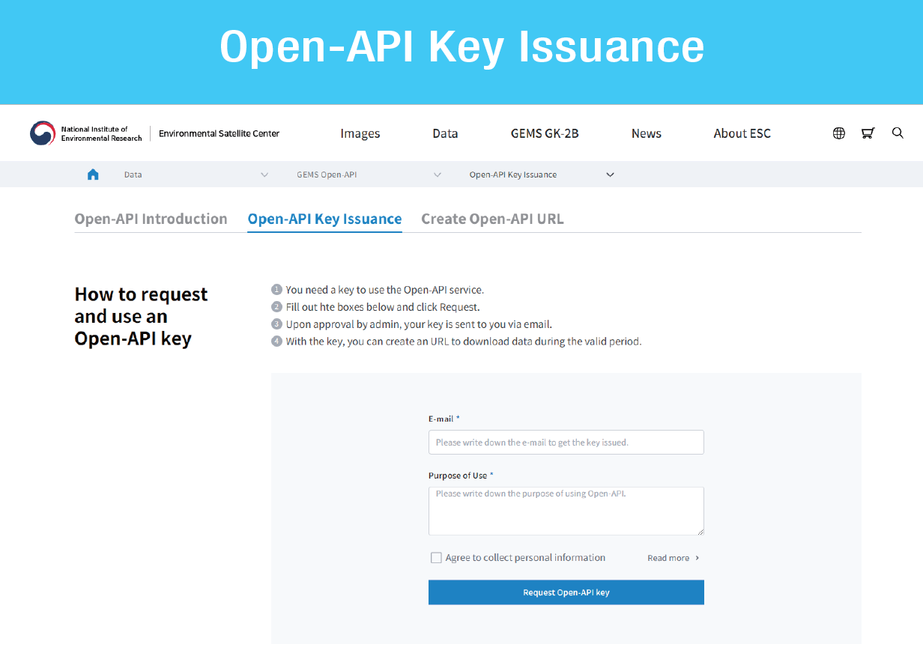
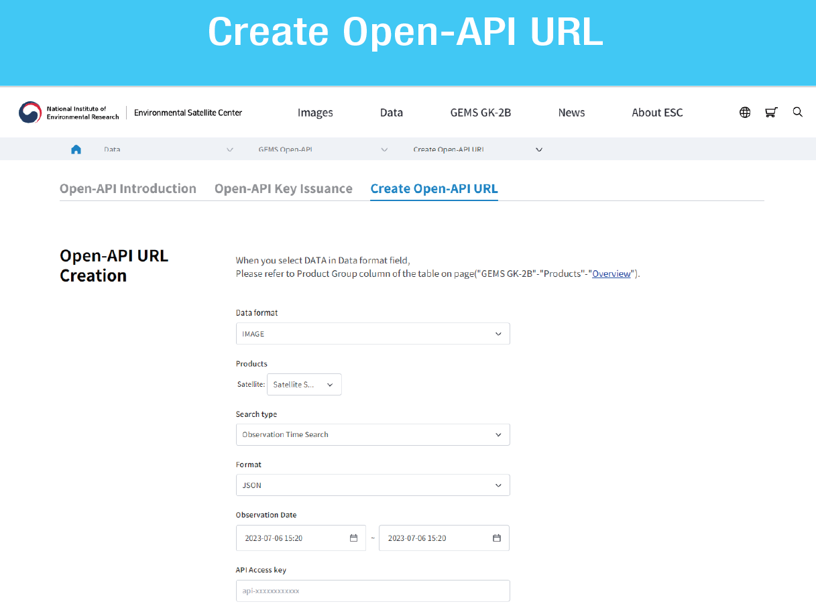
Current status of GEMS
Data distribution
Open-API (JUN 2023 - present)
The Open-API service requires a user key
Go to Open-API Key Issuance and request a key
Once your request is complete, your key code will be sent to you via email
You can use the key to create a URL for data download at the Create Open-API URL

Slide 7
Current status of GEMS
Data distribution
☯ Average number of downloads for each method and country (JAN 2023 – JUN 2024)
Download method
Top 7 countries
ESC website
OPEN-API
Taiwan
Others
Japan
Belgium
Germany
China
S. Korea
United States
SFTP
Total #: 5,254,431 including 98% of NetCDF and 2 % of image files (> 40 countries)

Slide 8
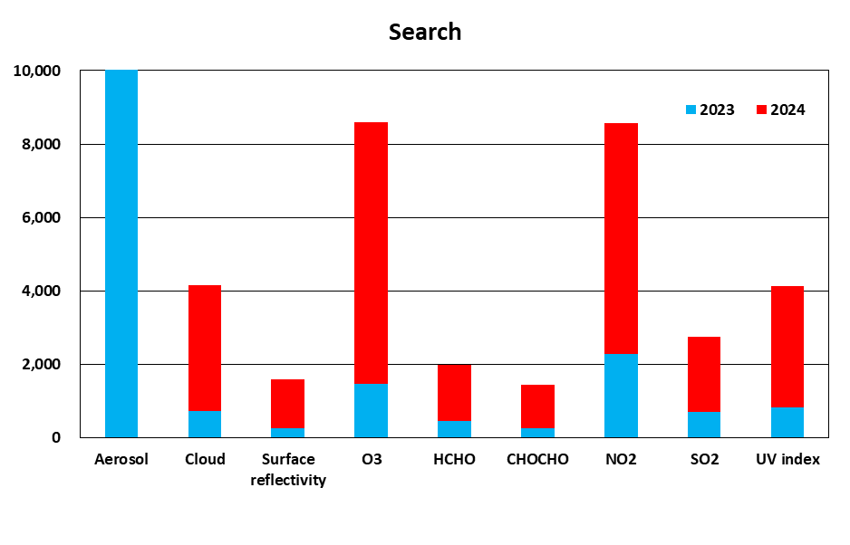
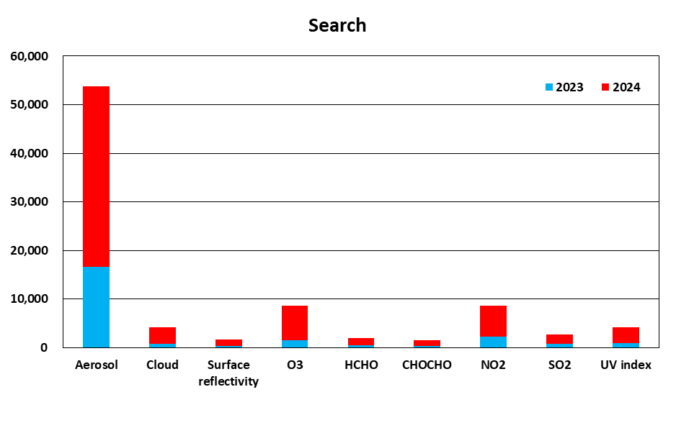
Current status of GEMS
Data distribution
☯ Average search number for each species (JAN 2023 – JUN 2024)
2023
2024

Slide 9
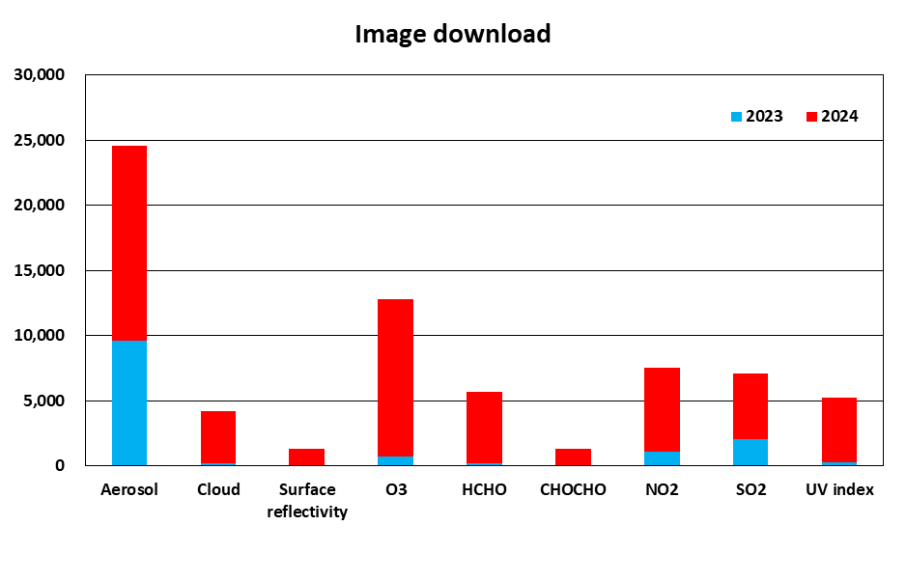
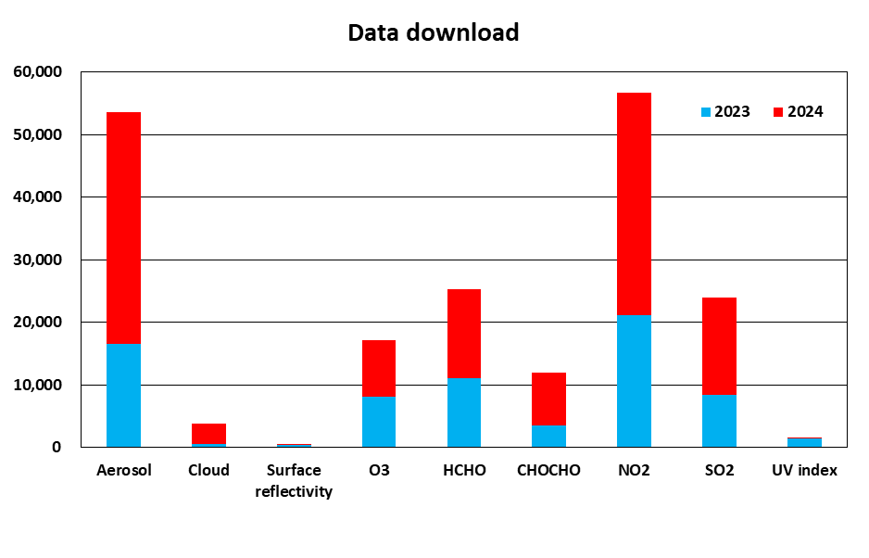
Current status of GEMS
Data distribution
☯ Average number of downloads for each species (JAN 2023 – JUN 2024)
Image downloads
Data downloads
2023
2024

Slide 10
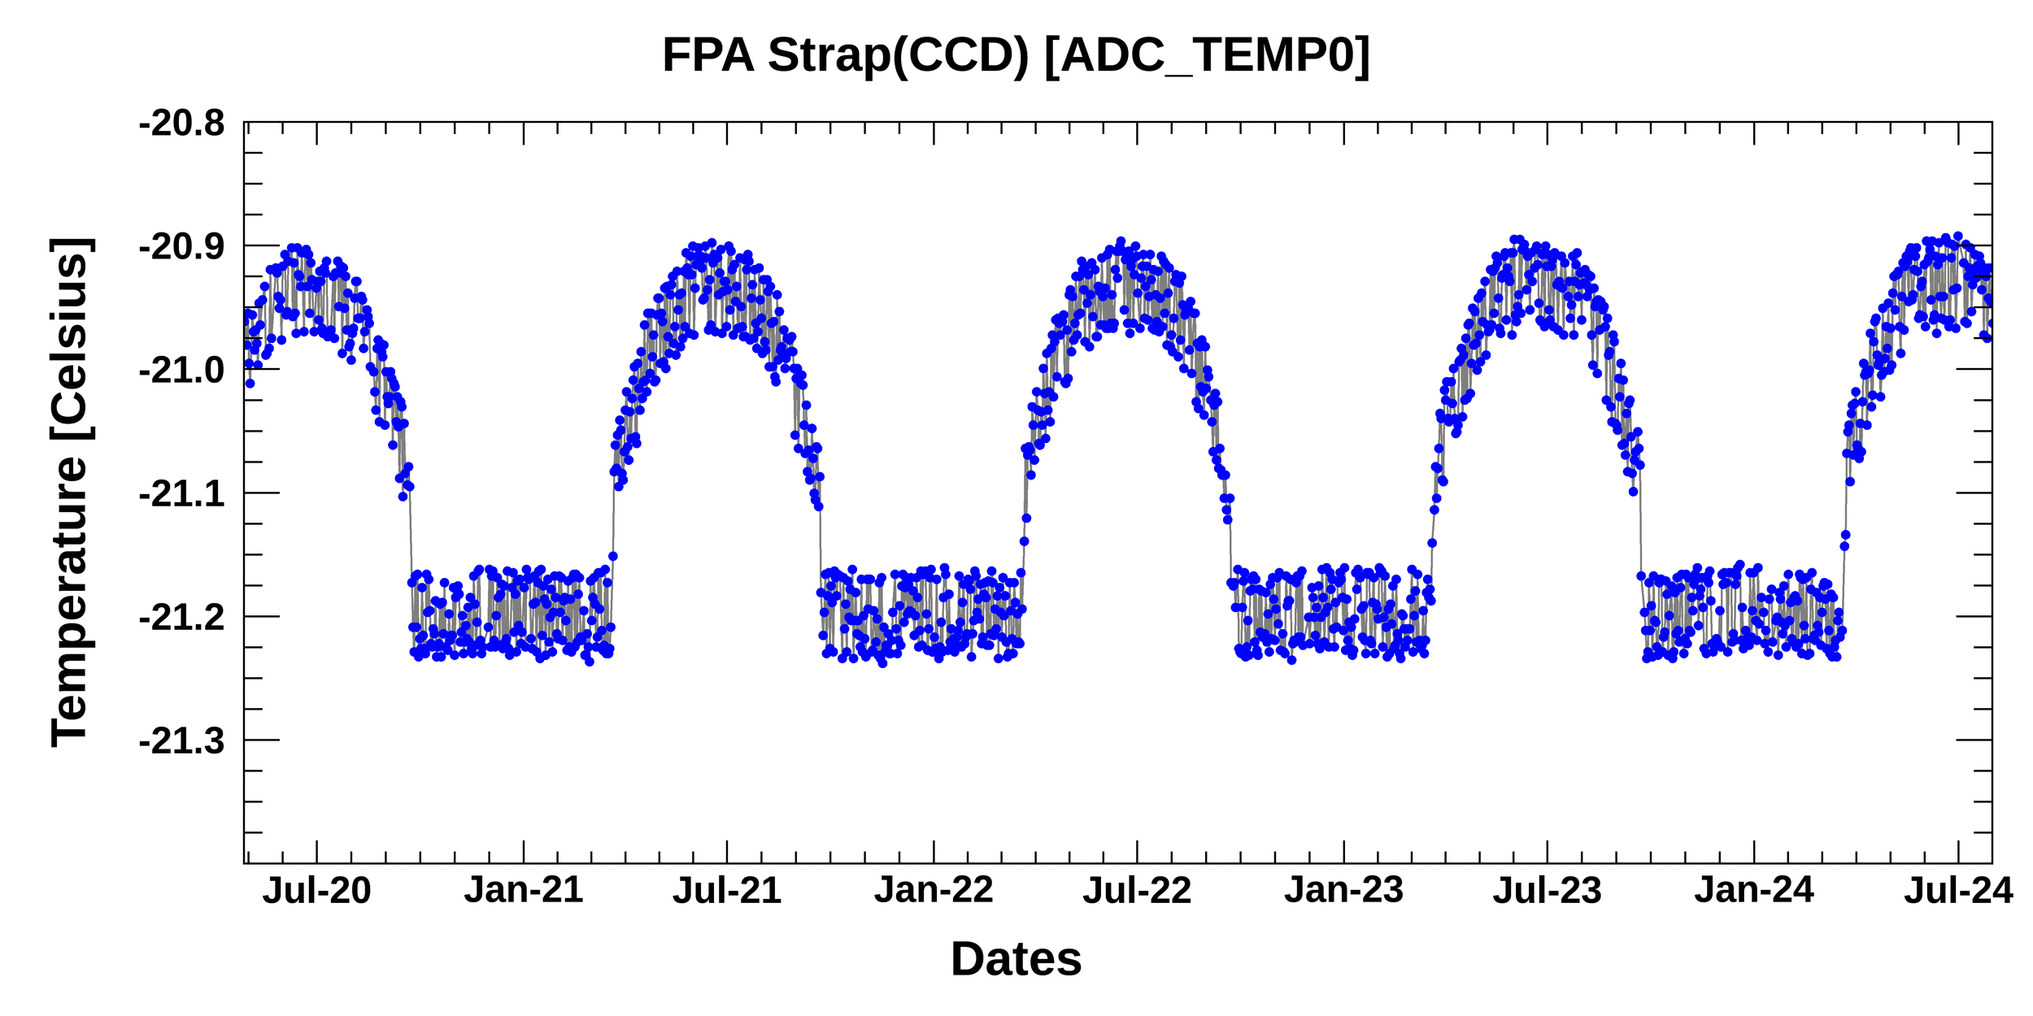
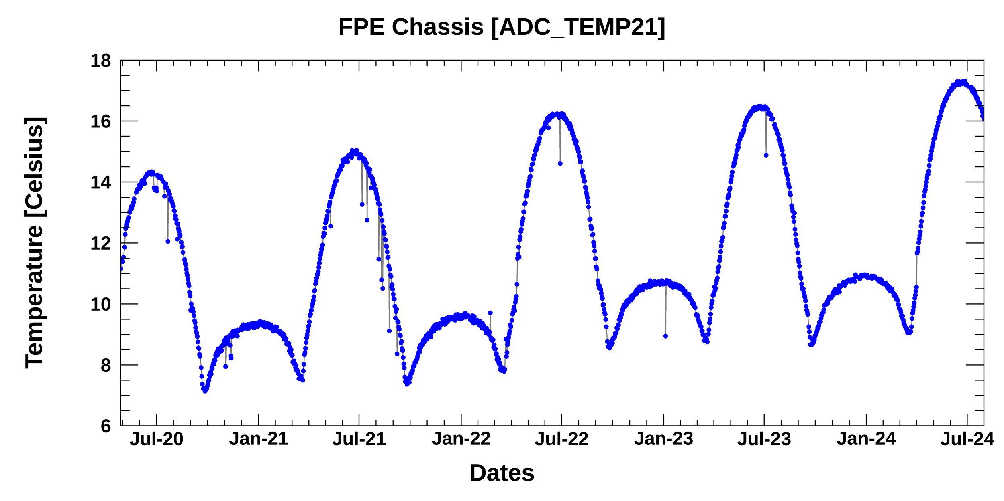
Current status of GEMS
Monitoring long-term GEMS data
☯ Telemetry
Seasonal & stable variability meets requirements
Variability of the Charge-coupled device (CCD) temperature is < 0.3 °C
2020
2024
Image credit: BATC
Focal plane electronics (FPE) temperature meets the criteria of -35°C to +65°C, but it has gradually increased
2020
2024
Image credit: BATC

Slide 11
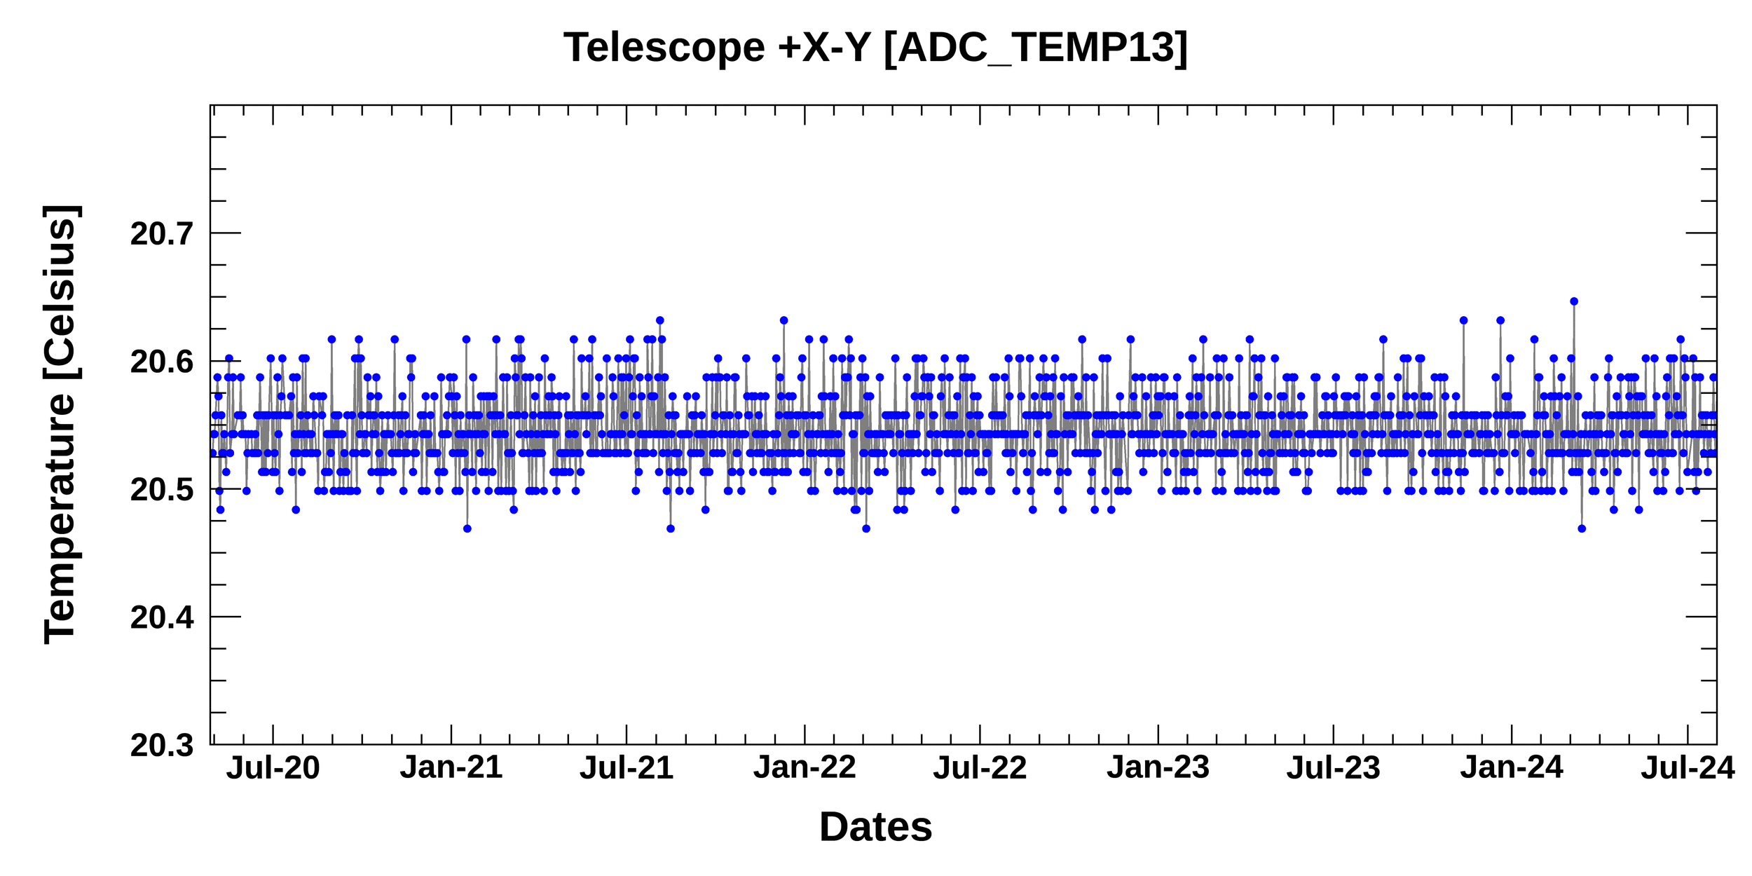
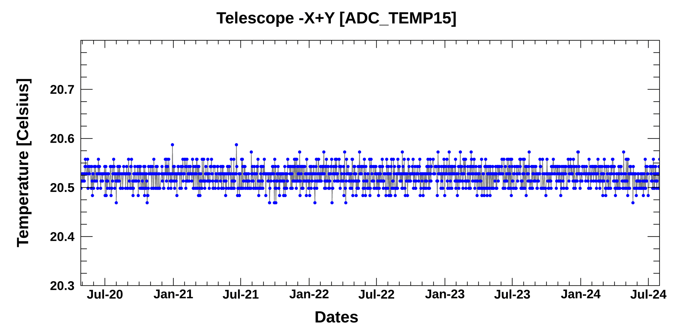
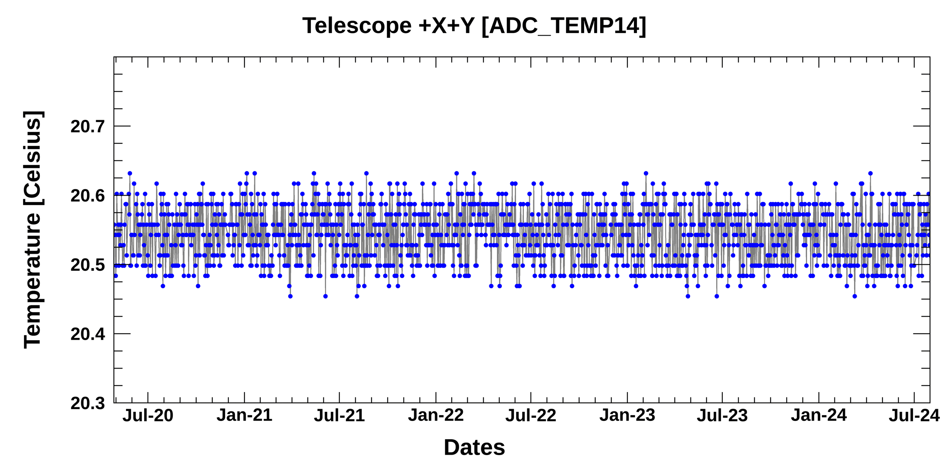
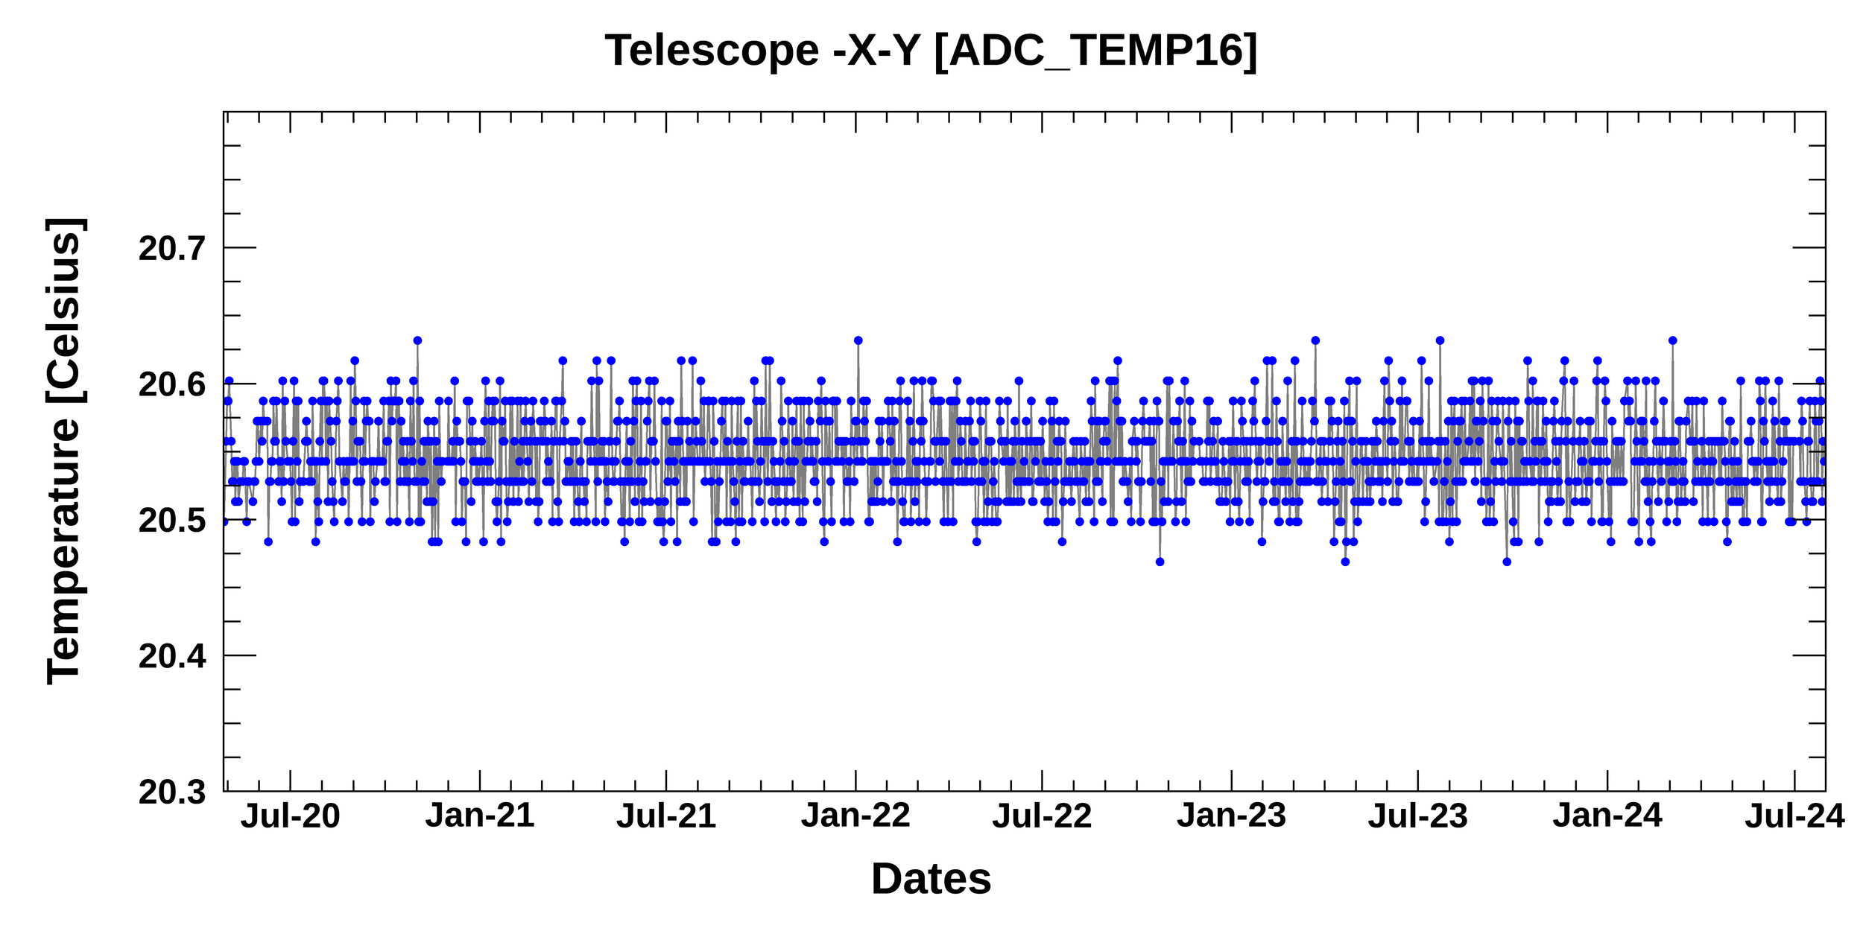
Current status of GEMS
Monitoring long-term GEMS data
☯ Telemetry
Stable temperature for the telescope
15
17
2020
2024
2020
2024
16
18
Image credit: BATC
2020
2024
2020
2024

Slide 12
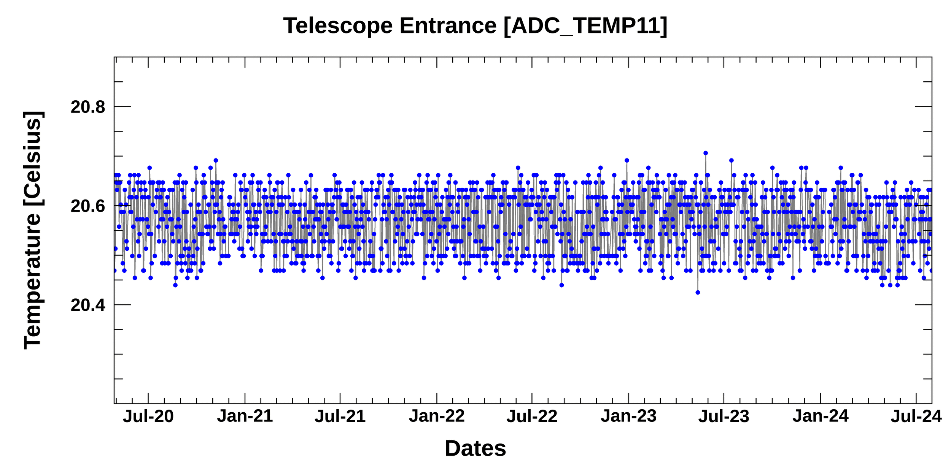
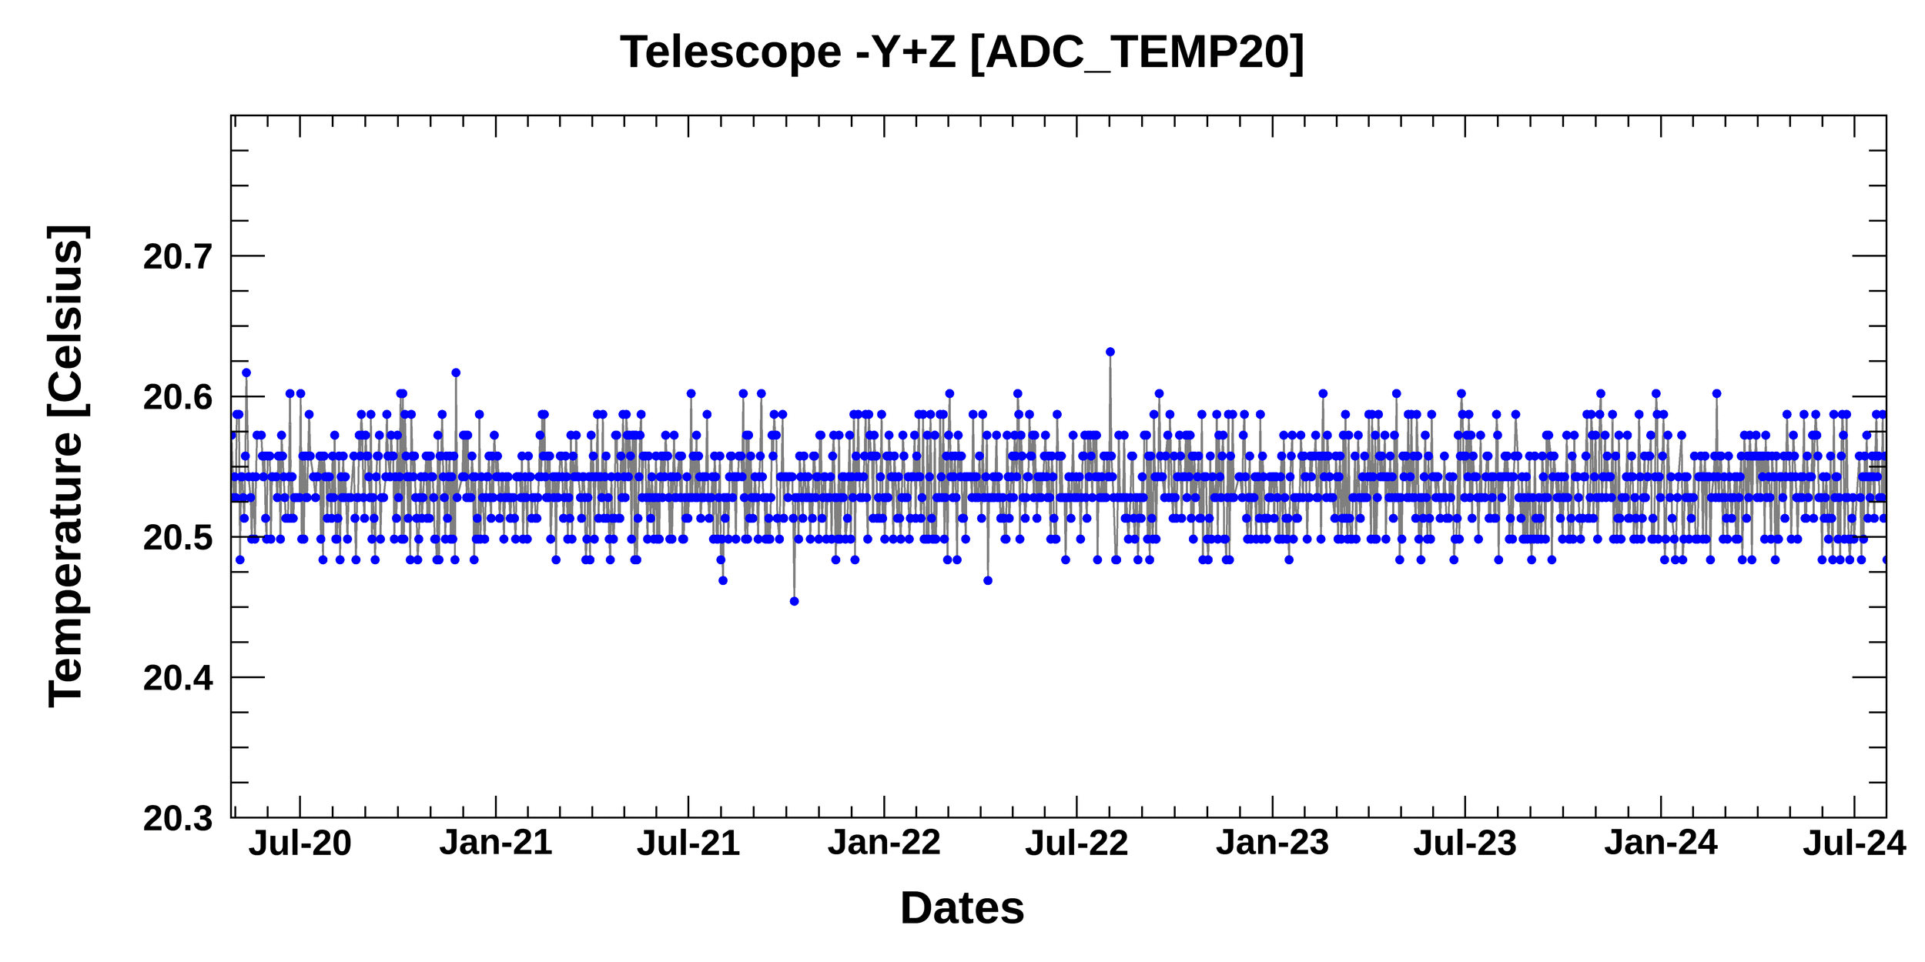
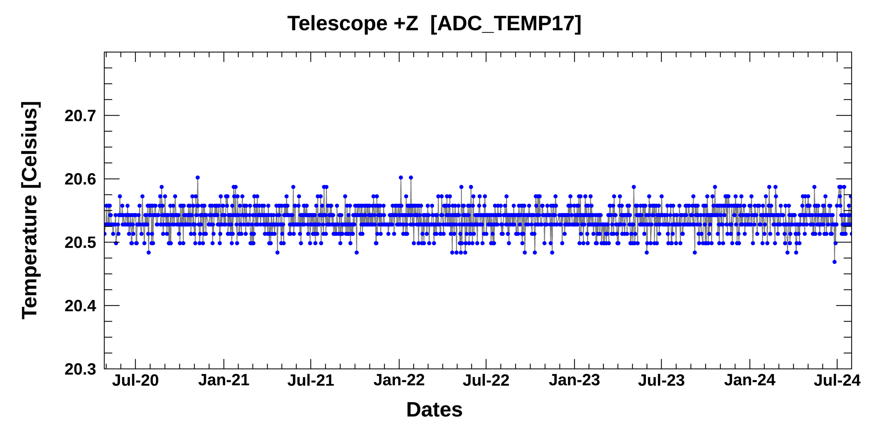
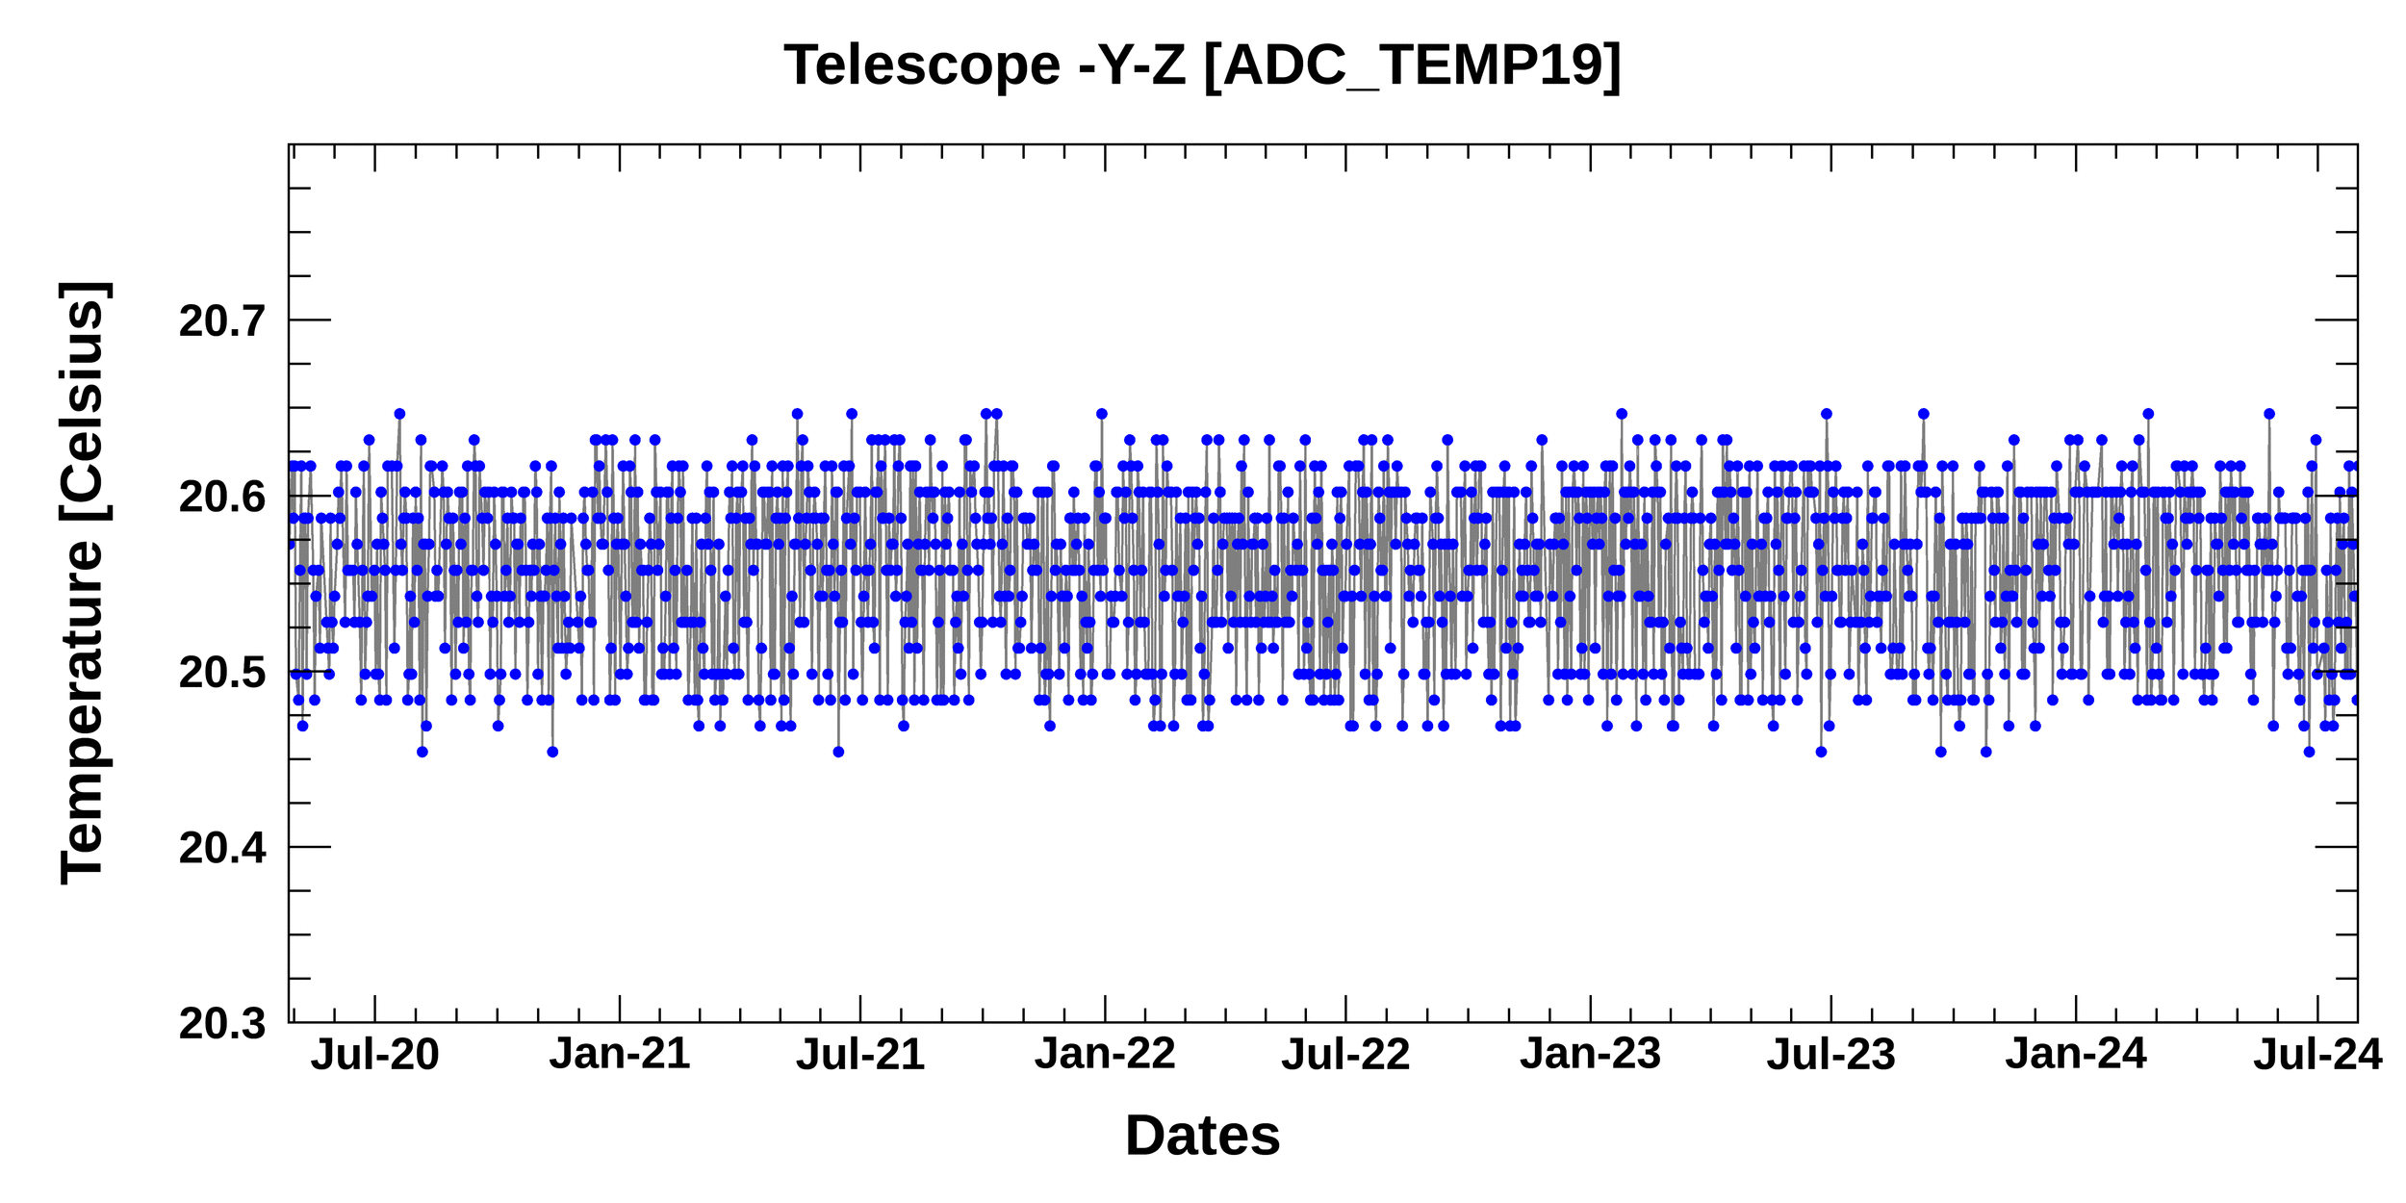
Current status of GEMS
Monitoring long-term GEMS data
☯ Telemetry
Stable temperature for the telescope
13
22
2020
2024
2020
2024
19
21
Image credit: BATC
2020
2024
2020
2024

Slide 13
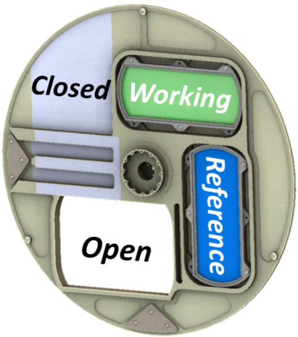
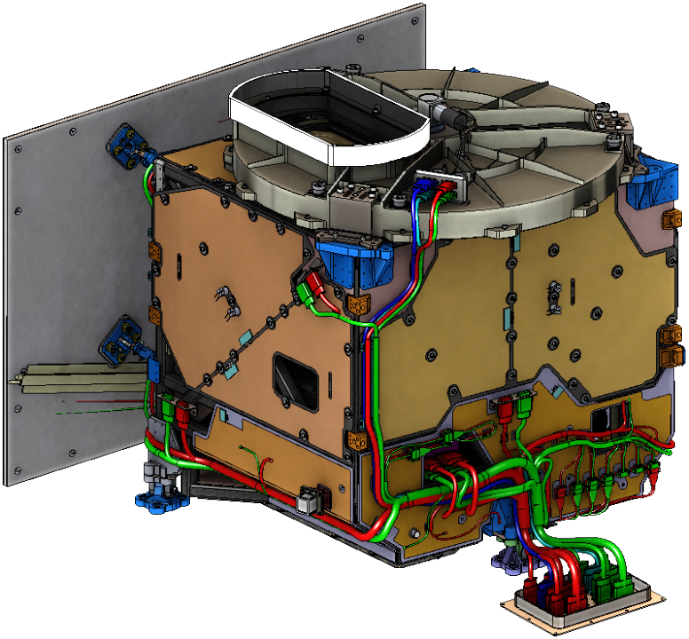
Current status of GEMS
Monitoring and maintaining calibration
Transmissive
Diffusers
Scene Selection Wheel
Observation |  | Frequency | Time | Comments
Earth |  | Avg. 8/day | HH:45 min – HH+1 hr:15 min (duration: 30 min) | CMA position: Open Schedule considering SKM, WOL
Solar | WSD | 1/day | Perform before/after local midnight at a sun-diffuser normal angle of 30.5° | CMA position: WD or RD Reschedule after midnight (16 – 17 UTC) if SKM is overlapped on regular observation time (13 – 14 UTC)
 | RSD | 2/year
Dark | Normal | 2/day (180 images) | Right before/after daytime Earth observation | CMA position: Close Normal: Additional observation after SKM, WOL
 | Solar | 1/day (2 images) | Right before solar observation
 | LED | 1/week (42 images) | Right after LED observation
LED |  | 1/week (17 UTC on Sunday) | After dark imaging and prior to solar calibration | CMA position: Close Observations at multiple integration times
Calibration Mechanism Assembly
Aperture
Radiator Assembly
Thermally-Controlled Composite Structure
WSD: Working solar diffuser
RSD: Reference solar diffuser
CMA: Calibration mechanism assembly
LED: Light emitting diode
CCD: Charge-coupled device (a light-sensitive integrated circuit)
Image credit: BATC

Slide 14
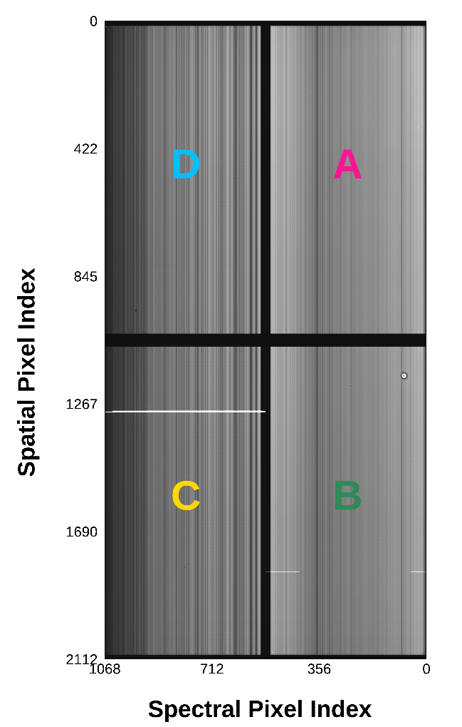
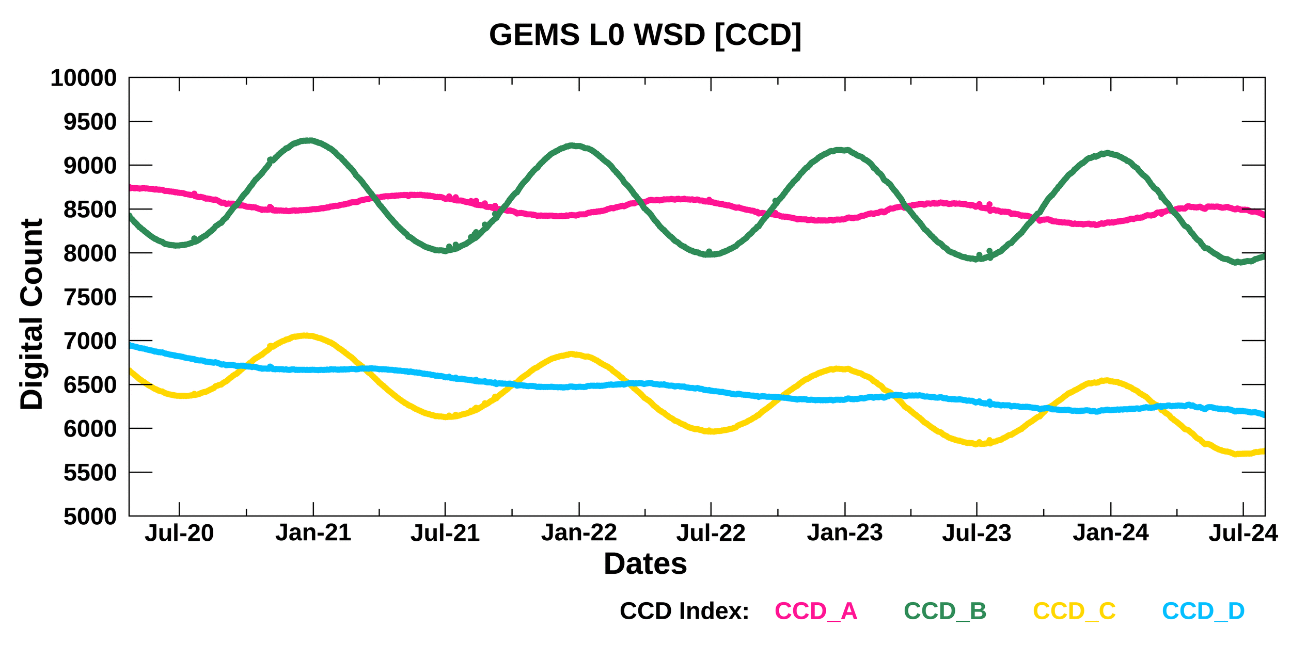
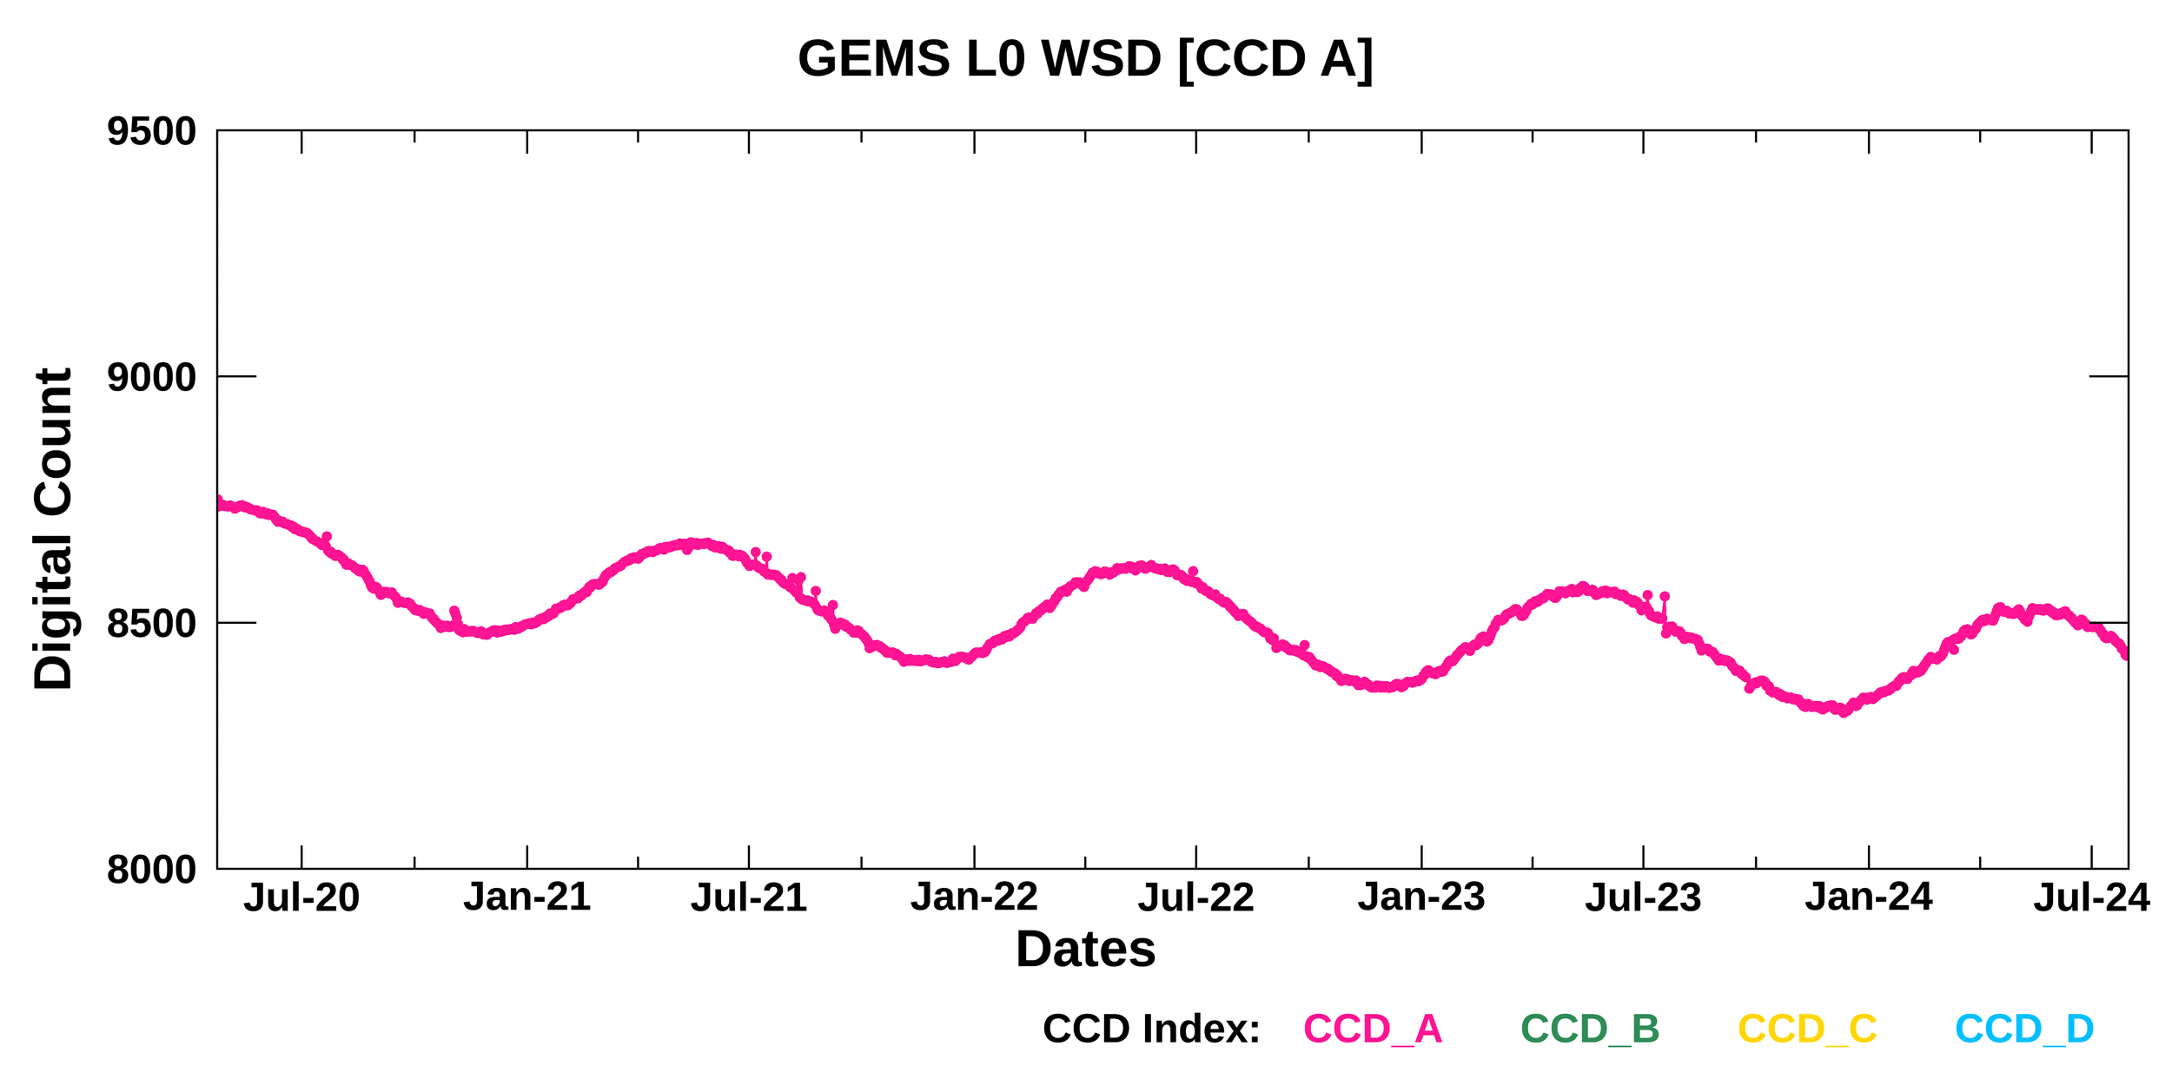
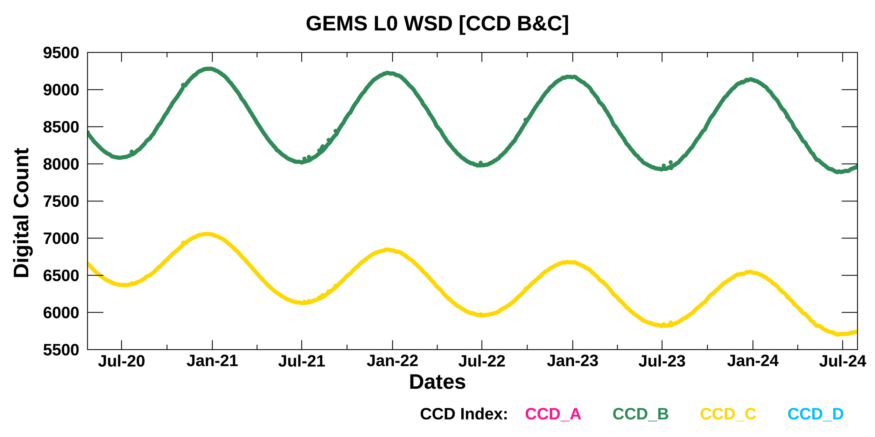
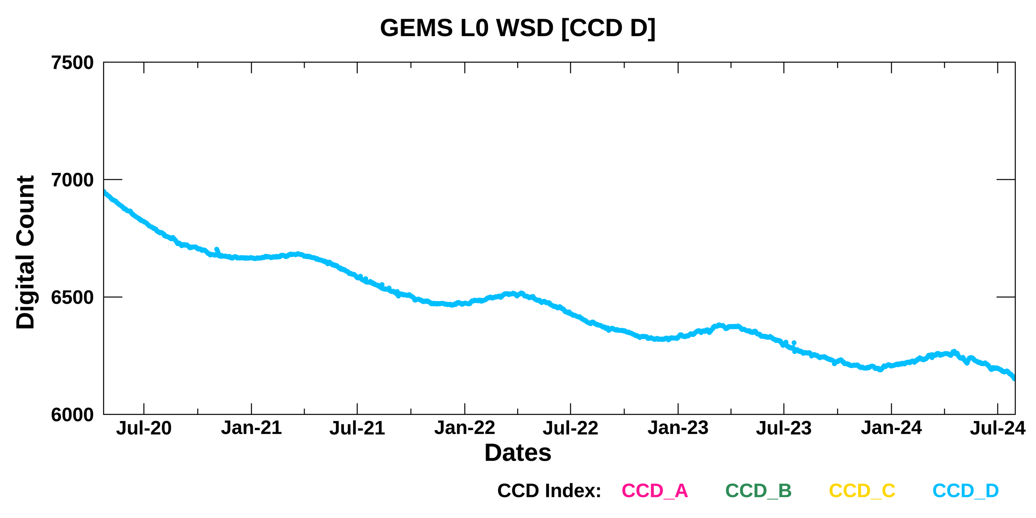
Current status of GEMS
Monitoring long-term GEMS data
☯ WSD (APR 2020 – JUL 2024)
CCD
N, 300nm
2020
2024
2020
2024
2020
2024
2020
2024
S, 500nm

Slide 15
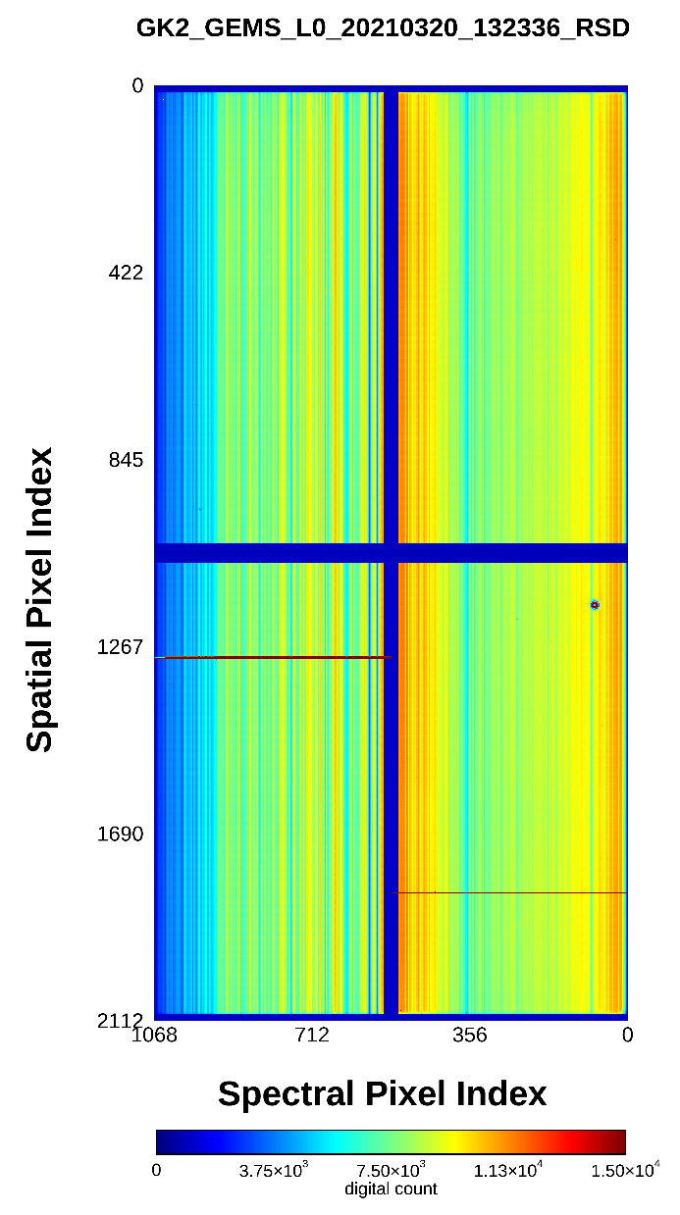
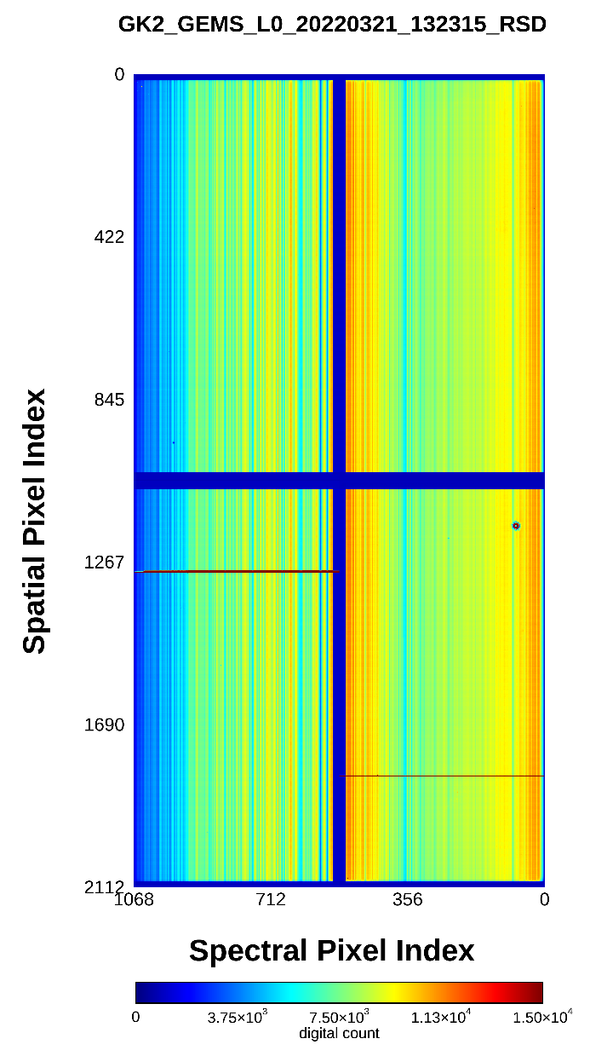
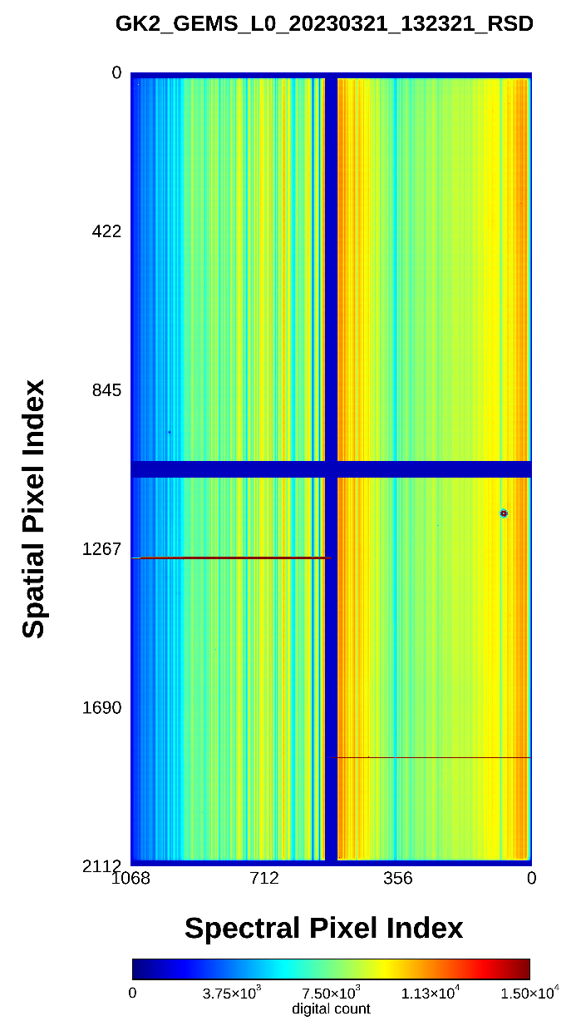
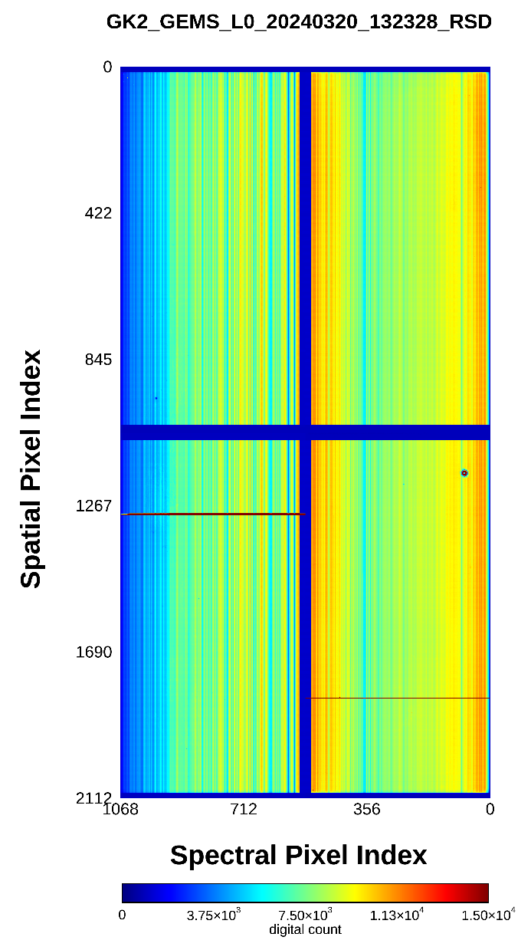
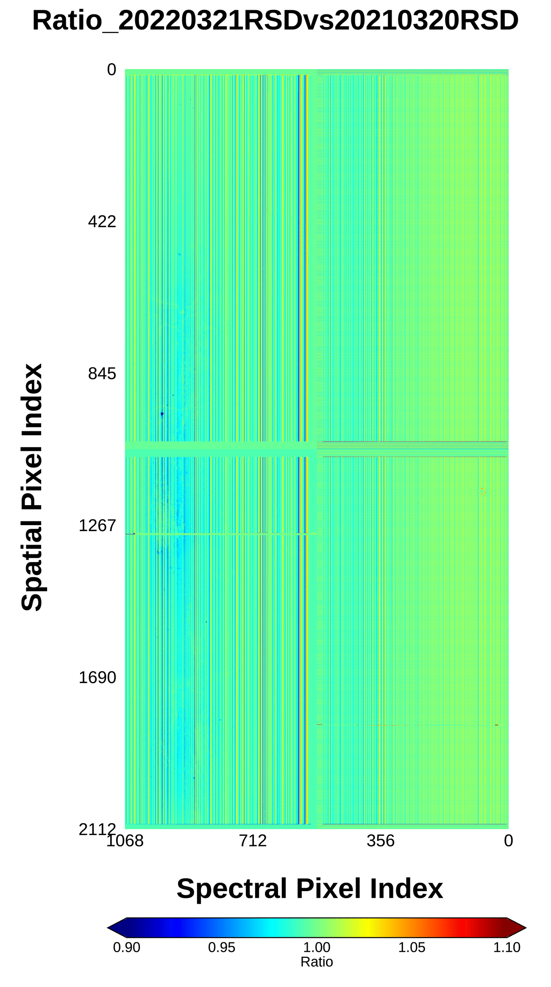
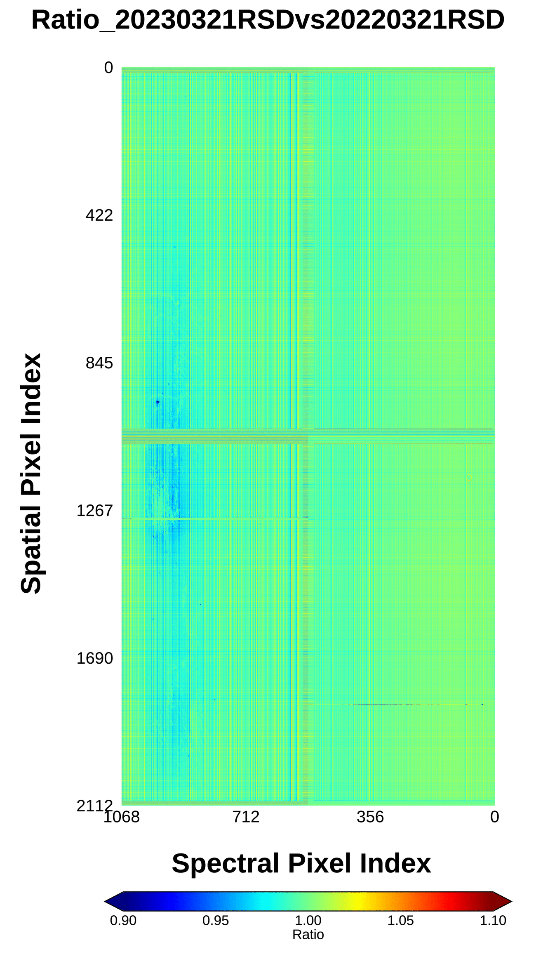
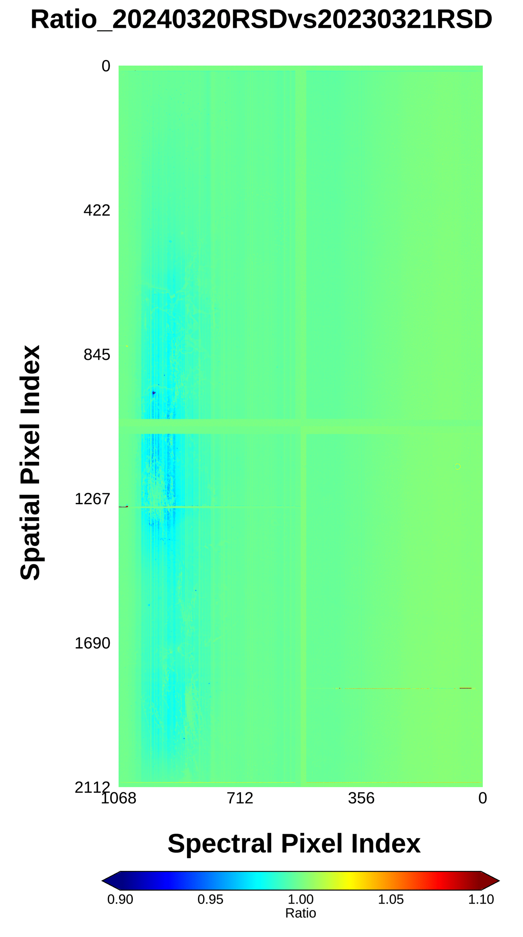
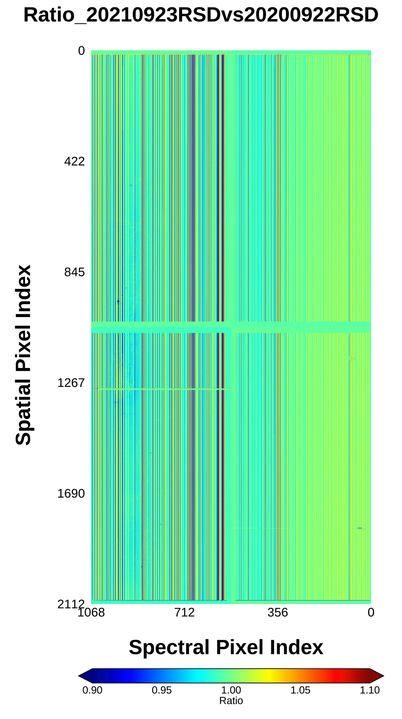
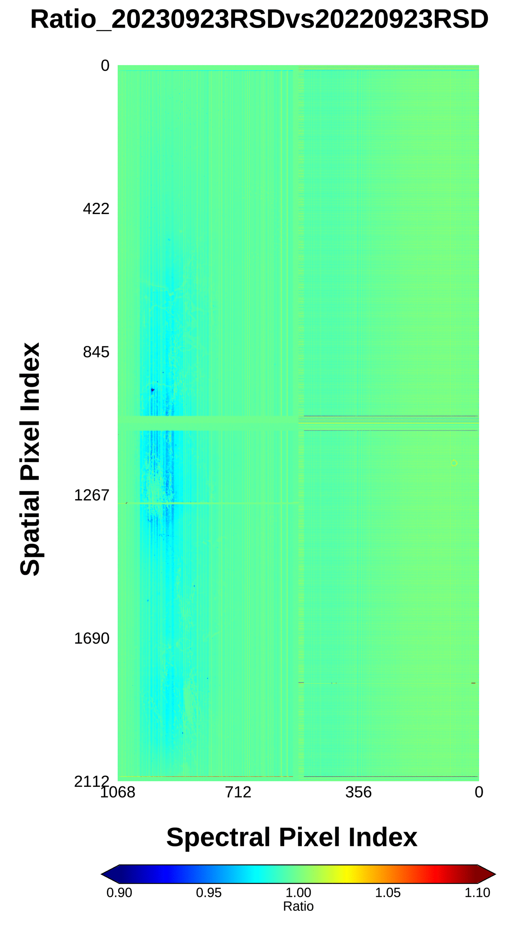
Current status of GEMS
Monitoring long-term GEMS data
☯ Degradation of L0 RSD
Exposure to the sun was conducted 11 times, resulting in a degradation of about 1%
Digital count
Differences
2021
2022
2023
2024
2022 - 2021
2023 - 2022
2024 - 2023
-0.48%
-0.43%
-0.25%
Vernal
equinox day
-0.57%
-0.35%
-0.45%
Autumnal
equinox day

Slide 16
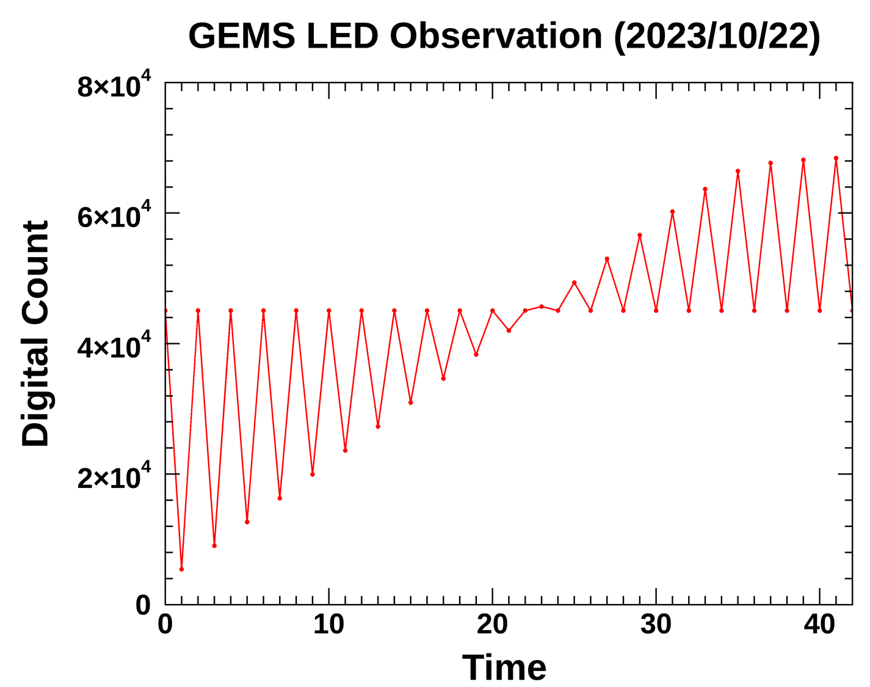
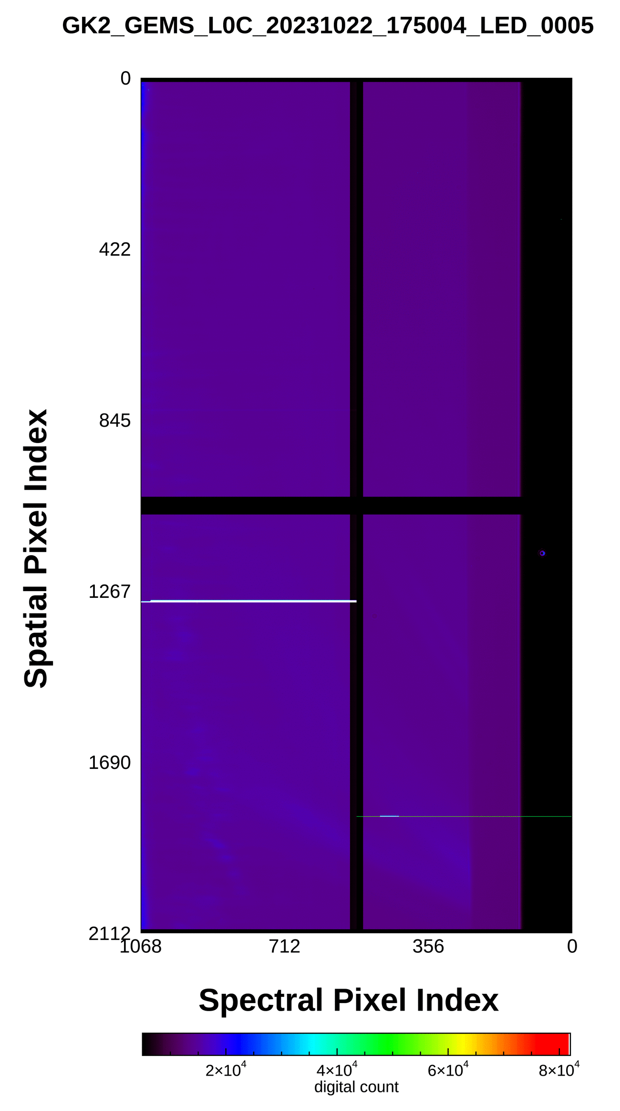
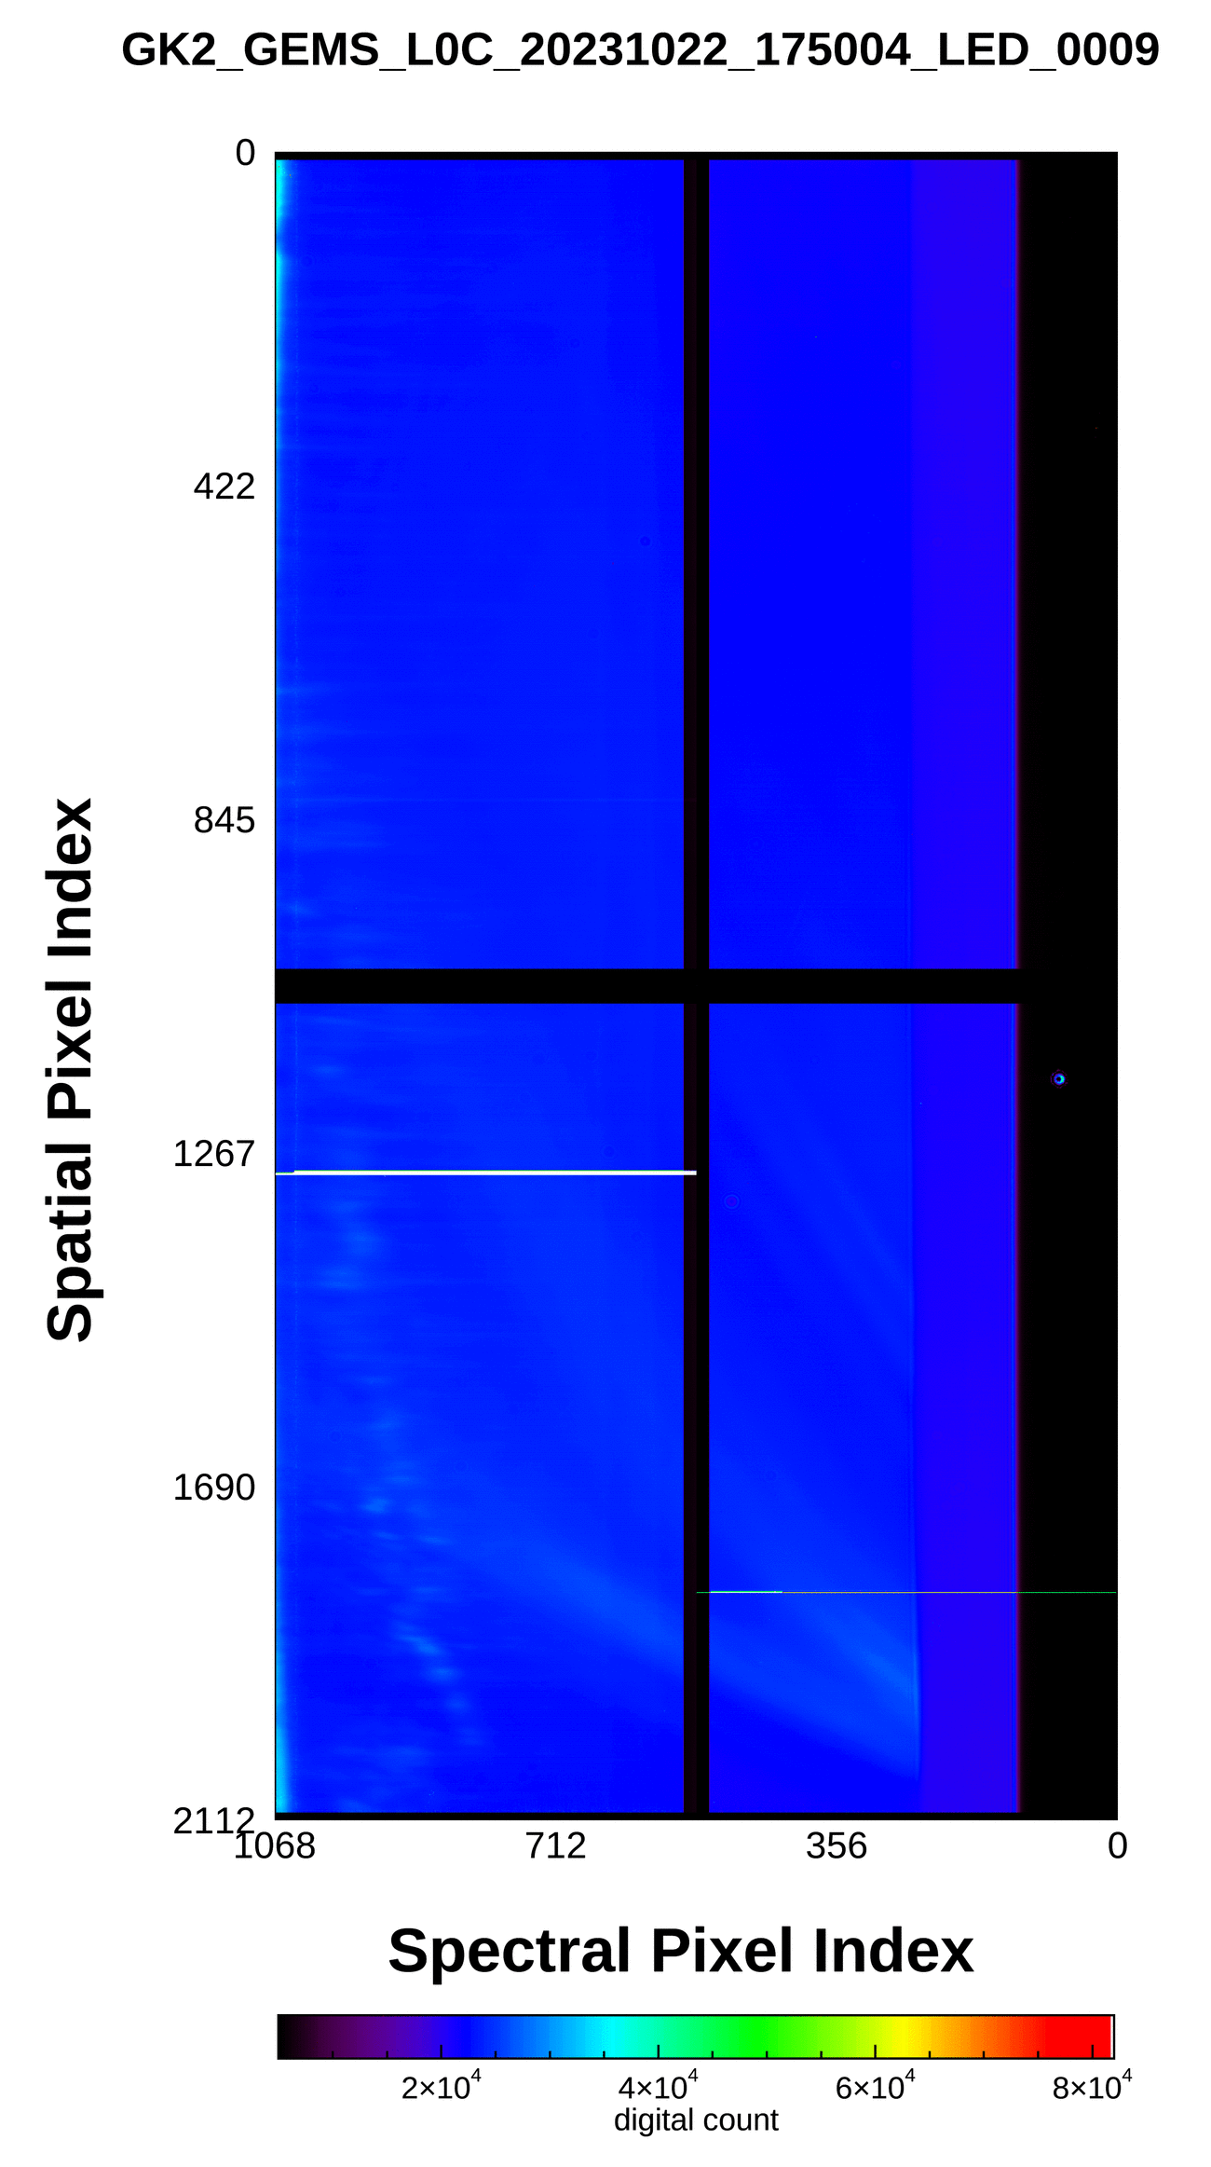
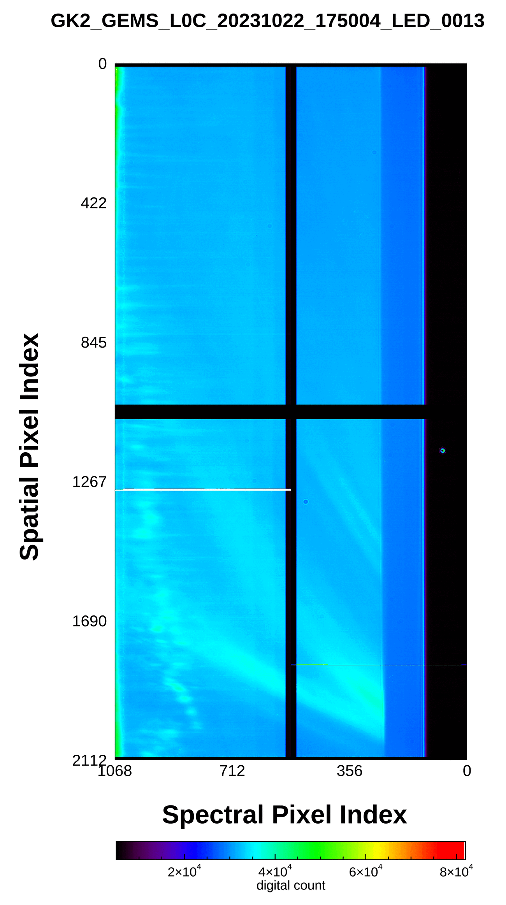
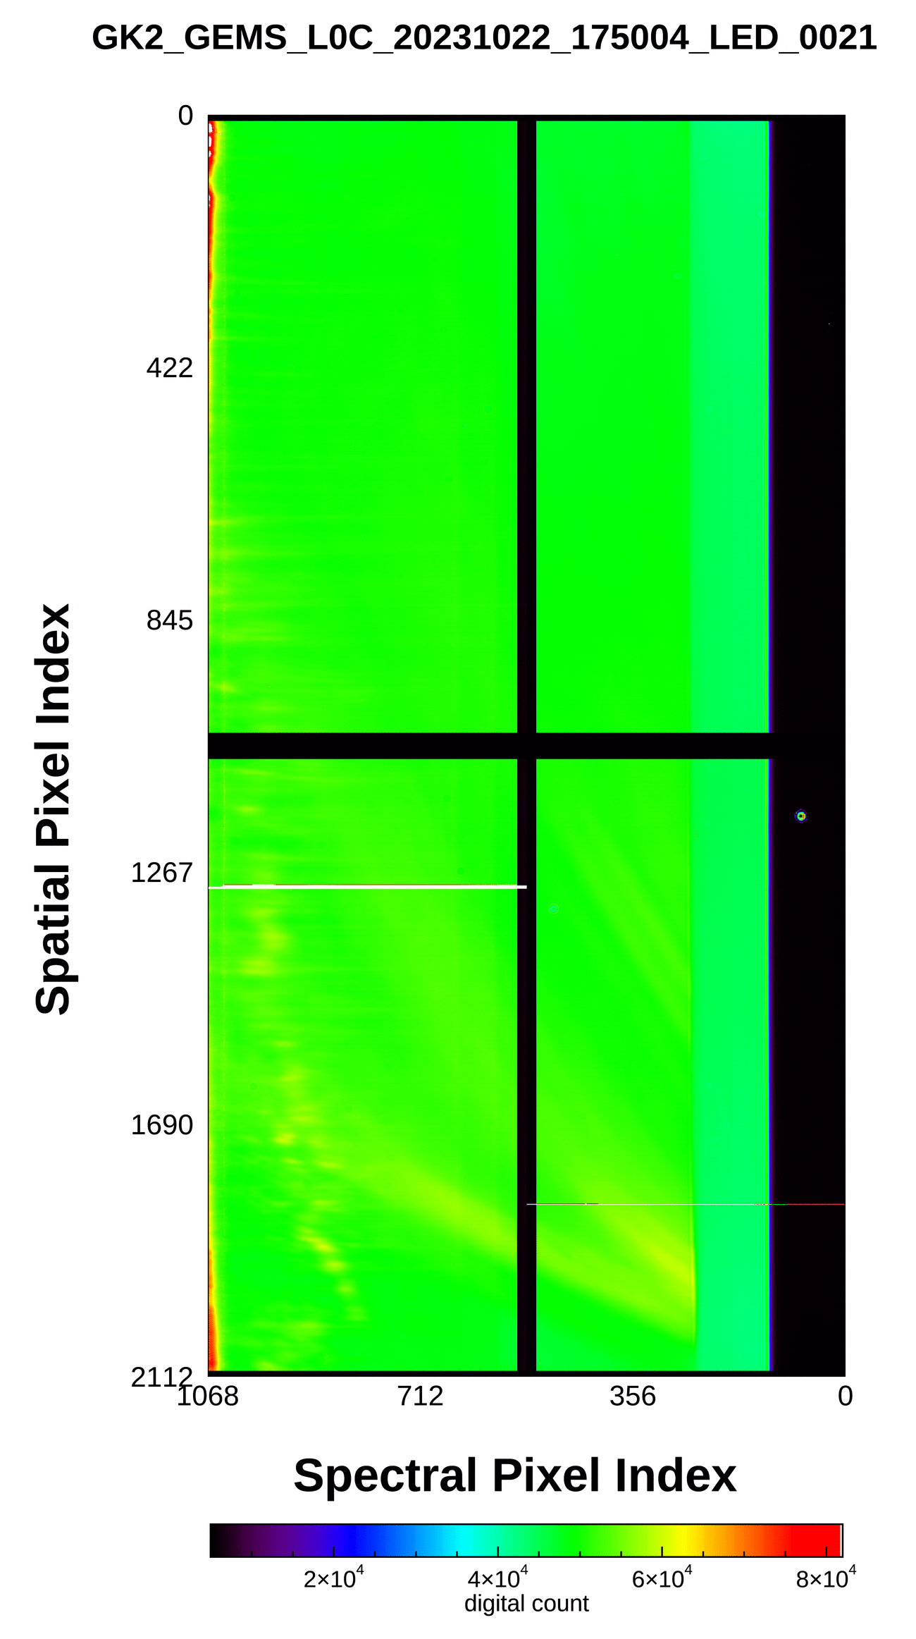
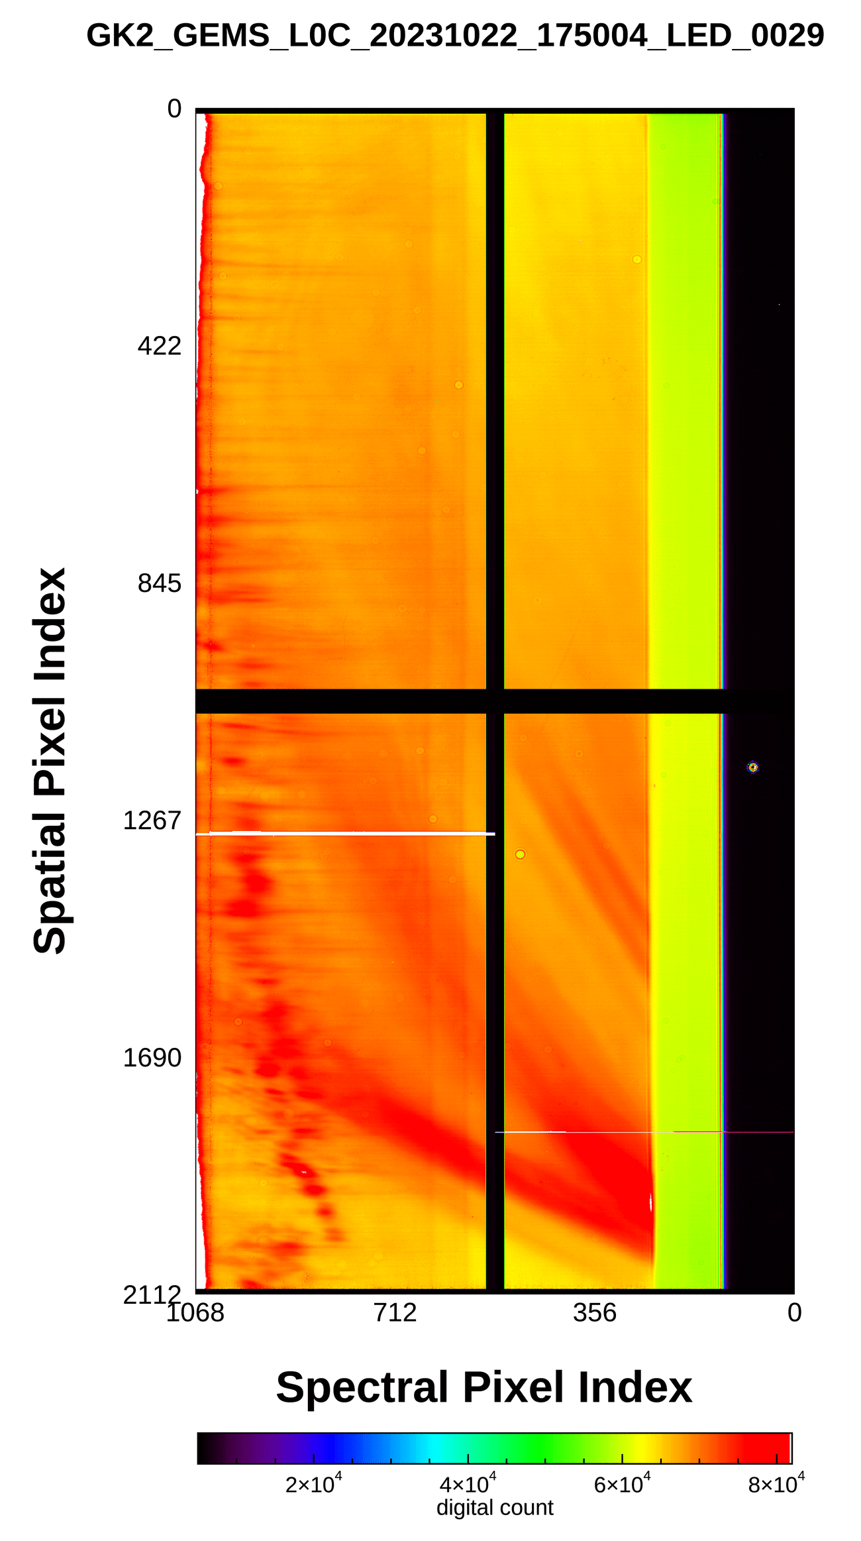
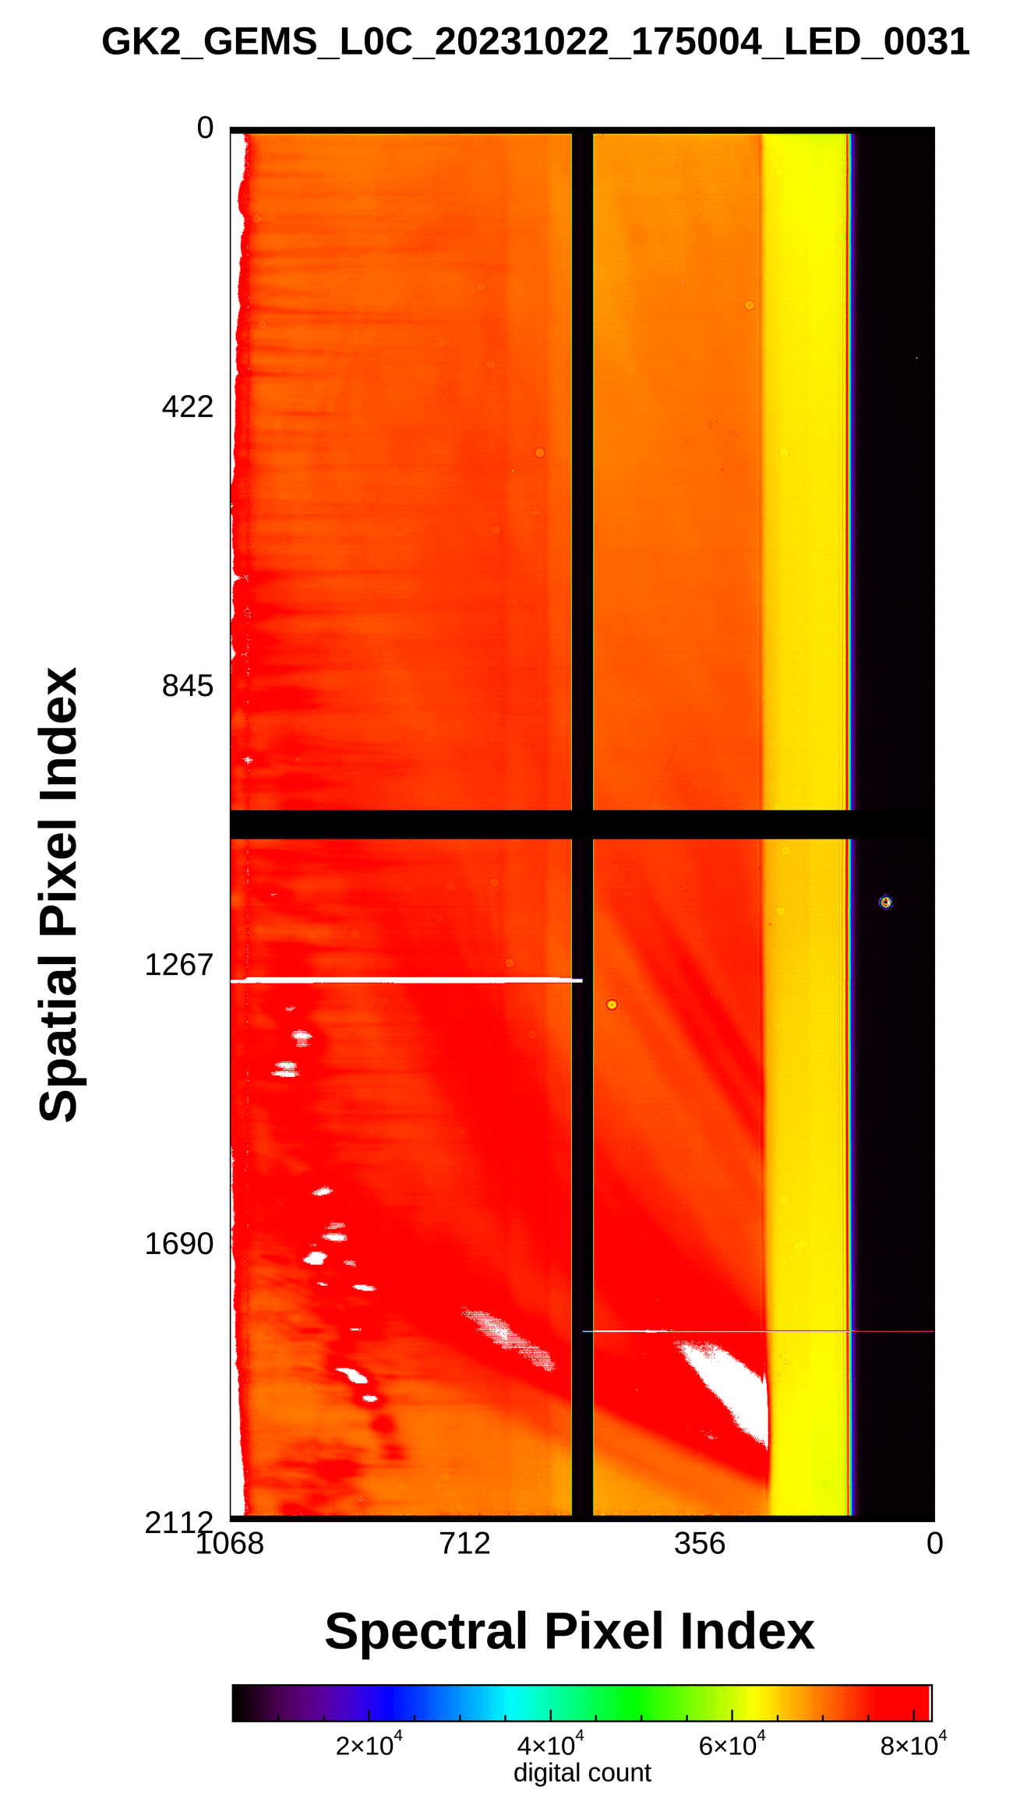
Current status of GEMS
Monitoring long-term GEMS data
☯ LED
Linearity of the CCD by using LED signals
Increasing Integration time
Reference

Slide 17
Current status of GEMS
Inter-comparison between GEMS and the Advanced Meteorological Imager (AMI)
☯ Spatiotemporal collocation
Temporal collocation: Using AMI data -10, 0, + 10 min from GEMS observation time
Spatial collocation: AMI 1 km by 1 km → 3.5 km by 8 km (to GEMS domain)
Image credit: Ewha Womans University

Slide 18
Current status of GEMS
Inter-comparison between GEMS and AMI
☯ Spectral collocation
Collocation of GEMS data using AMI SRF to compare with AMI VIR004 band (central wavelength at 470 nm)
Image credit: Ewha Womans University
$$L⨂f= \frac{\int_{λ_{i}}^{λ_{f}}{L_{λ}∙f_{λ}} dλ}{\int_{λ_{i}}^{λ_{f}}{f_{λ}} dλ}$$
$L(λ):GEMS spectral data$
$f\left(λ\right):AMI Spectral response function (SRF)$

Slide 19
Current status of GEMS
Inter-comparison between GEMS and AMI
☯ Cloud effect removal
Comparison by considering clear pixels using cloud mask
Collocated AMI cloud
Collocated radiance diff. w/ cloud
Collocated radiance diff. w/o cloud
2023.01.01 02:45
2023.01.01 02:45 GEMS - AMI
2023.01.01 02:45 GEMS - AMI

Slide 20
Current status of GEMS
Inter-comparison between GEMS and AMI
☯ Geometric differences (JAN – DEC 2023)
Almost 1-2 pixels difference in RMSE analysis
Sometimes, a reversal trend occurs after rebooting GEMS
JAN 4 2023
JUL 17 2023
SEP 24 2023
DEC 10 2023
w/o cloud mask
N-S
E-W
w/ cloud mask
N-S
E-W

Slide 21
Current status of GEMS
Inter-comparison between GEMS and AMI
☯ Geometric differences (JAN – MAY 2024)
Almost 1-2 pixels difference in RMSE analysis
GEMS did not require a reboot as no issues were encountered
w/o cloud mask
N-S
N-S
E-W
w/ cloud mask
N-S
N-S
E-W

Slide 22
Current status of GEMS
Inter-comparison between GEMS and AMI
☯ Radiometric difference (JAN 2023 – MAY 2024)
Dramatic change in correlation coefficient and bias after rebooting GEMS
w/o cloud mask
w/ cloud mask
SEP 24 2023
JAN 4 2023
JUL 17 2023
DEC 10 2023

Slide 23
Future plans
To achieve 100 % success rates in receiving and retrieving GEMS data
To monitor and analyze GEMS telemetry, solar observations, and L1 data
To conduct intercomparison with other satellites (GEO-GEO, GEO-LEO)

Slide 24
2024 TEMPO/GEMS Joint Science Team Workshop
Thank you for your attention.

